Slide 1
Investigating Chromatin Structure using Deep Learning Models
Name: Sony Annem
Advisor: Dr. Minjeong Kim
Notes:
Useful technique words, time steps, time frame, input shape , batch size

Slide 2
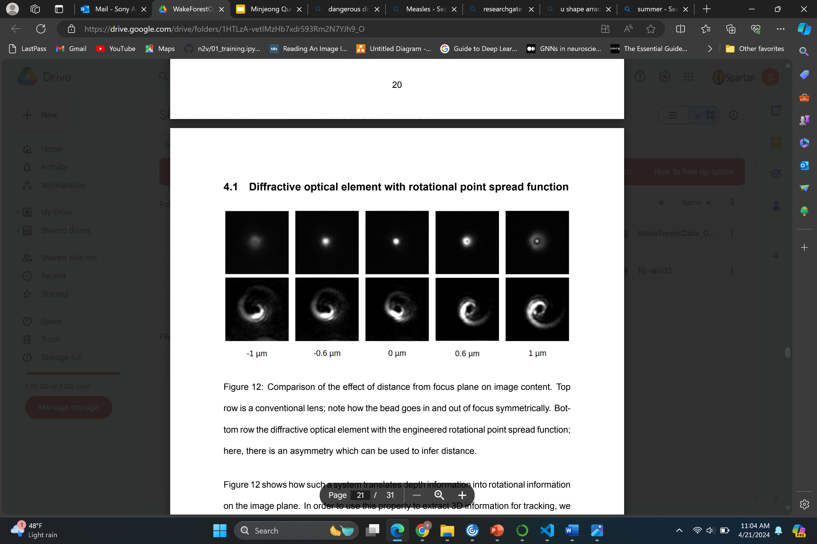
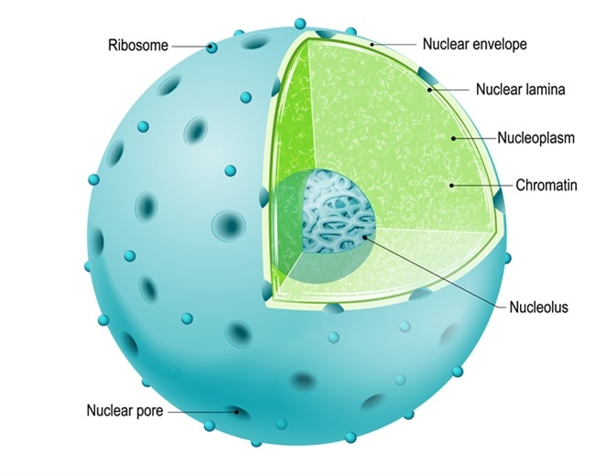
Motive behind the project:
Chromatin is a structure present within the cell nucleus. The reason behind studying chromatin structure is to analyze both efficacy and risk of cancer drugs. When a section of DNA is being expressed or repaired, chromatin assumes to be a more spread-out state.
Cell
Chromatin substance with rotational point spread function
The goal of our project is to exactly identify the center position of chromatin substance using Deep Learning Models
Notes:
Based on the chromatin movements doctors stops the chemotherapy treatment.,chromati substance viewing under the microscopic slides if the DNA is damaged the chromatin is in more spread-out state.By investigating chromatin helps
to maintain DNA damage. Helps to give chemotherapy without damaging the DNA .
Heading 24 nd text 18 our goal is to identify the center position

Slide 3
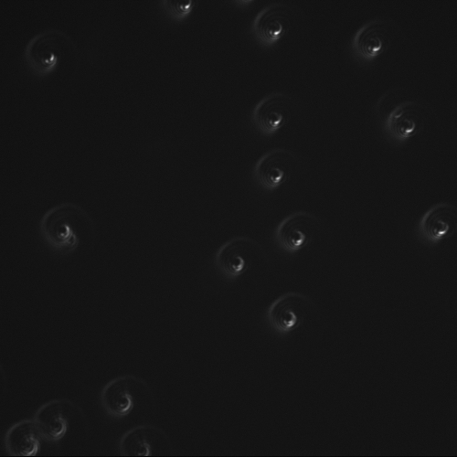
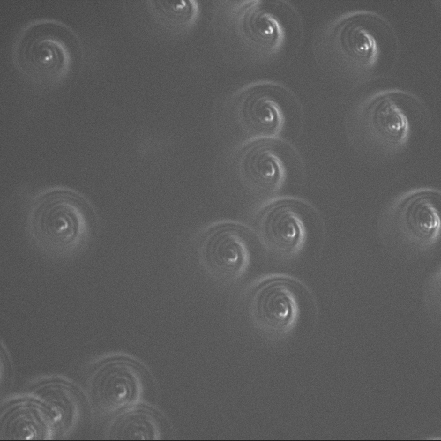
About Dataset:
We've received the dataset from Wake Forest School of Medicine consisting of approximately 160 TIFF images. Each TIFF image contains a sequence of either 61 or 122 frames capturing chromatin movement.
The dataset includes images captured both with and without cell movement. Images labeled as "NOSPP" are captured when cells are stationary and are considered as ground truth.
On the other hand, images labeled as "SPP" are captured during when cells are in movement and are the primary focus of our analysis.
11.11.21_SPP_Fov8_1_NDTiffStack_frame_35
11.11.21_NOSPP_Fov8_1_NDTiffStack_frame_35
Fig 2: Data Examples

Slide 4
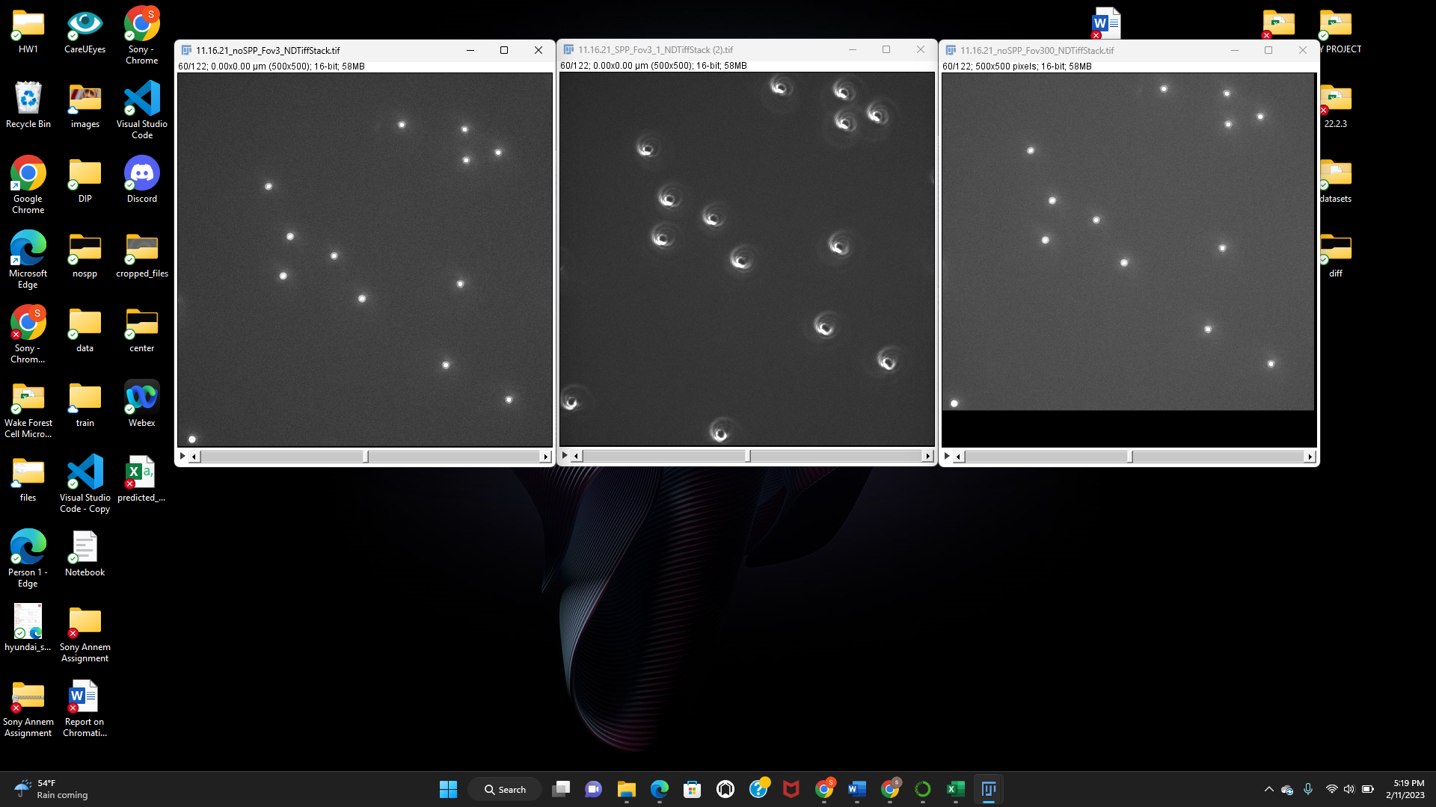
Dataset Preprocessing:
We observed that there is some drift in between the SPP images and the NOSPP images(ground truth) so we performed Image Translation.
Fig 3: Left image is the NOSPP, Middle image is the SPP image for comparison, and Right image is the translated version (translation parameters 2.7 on x axis and 47.7 on y-axis).

Slide 5
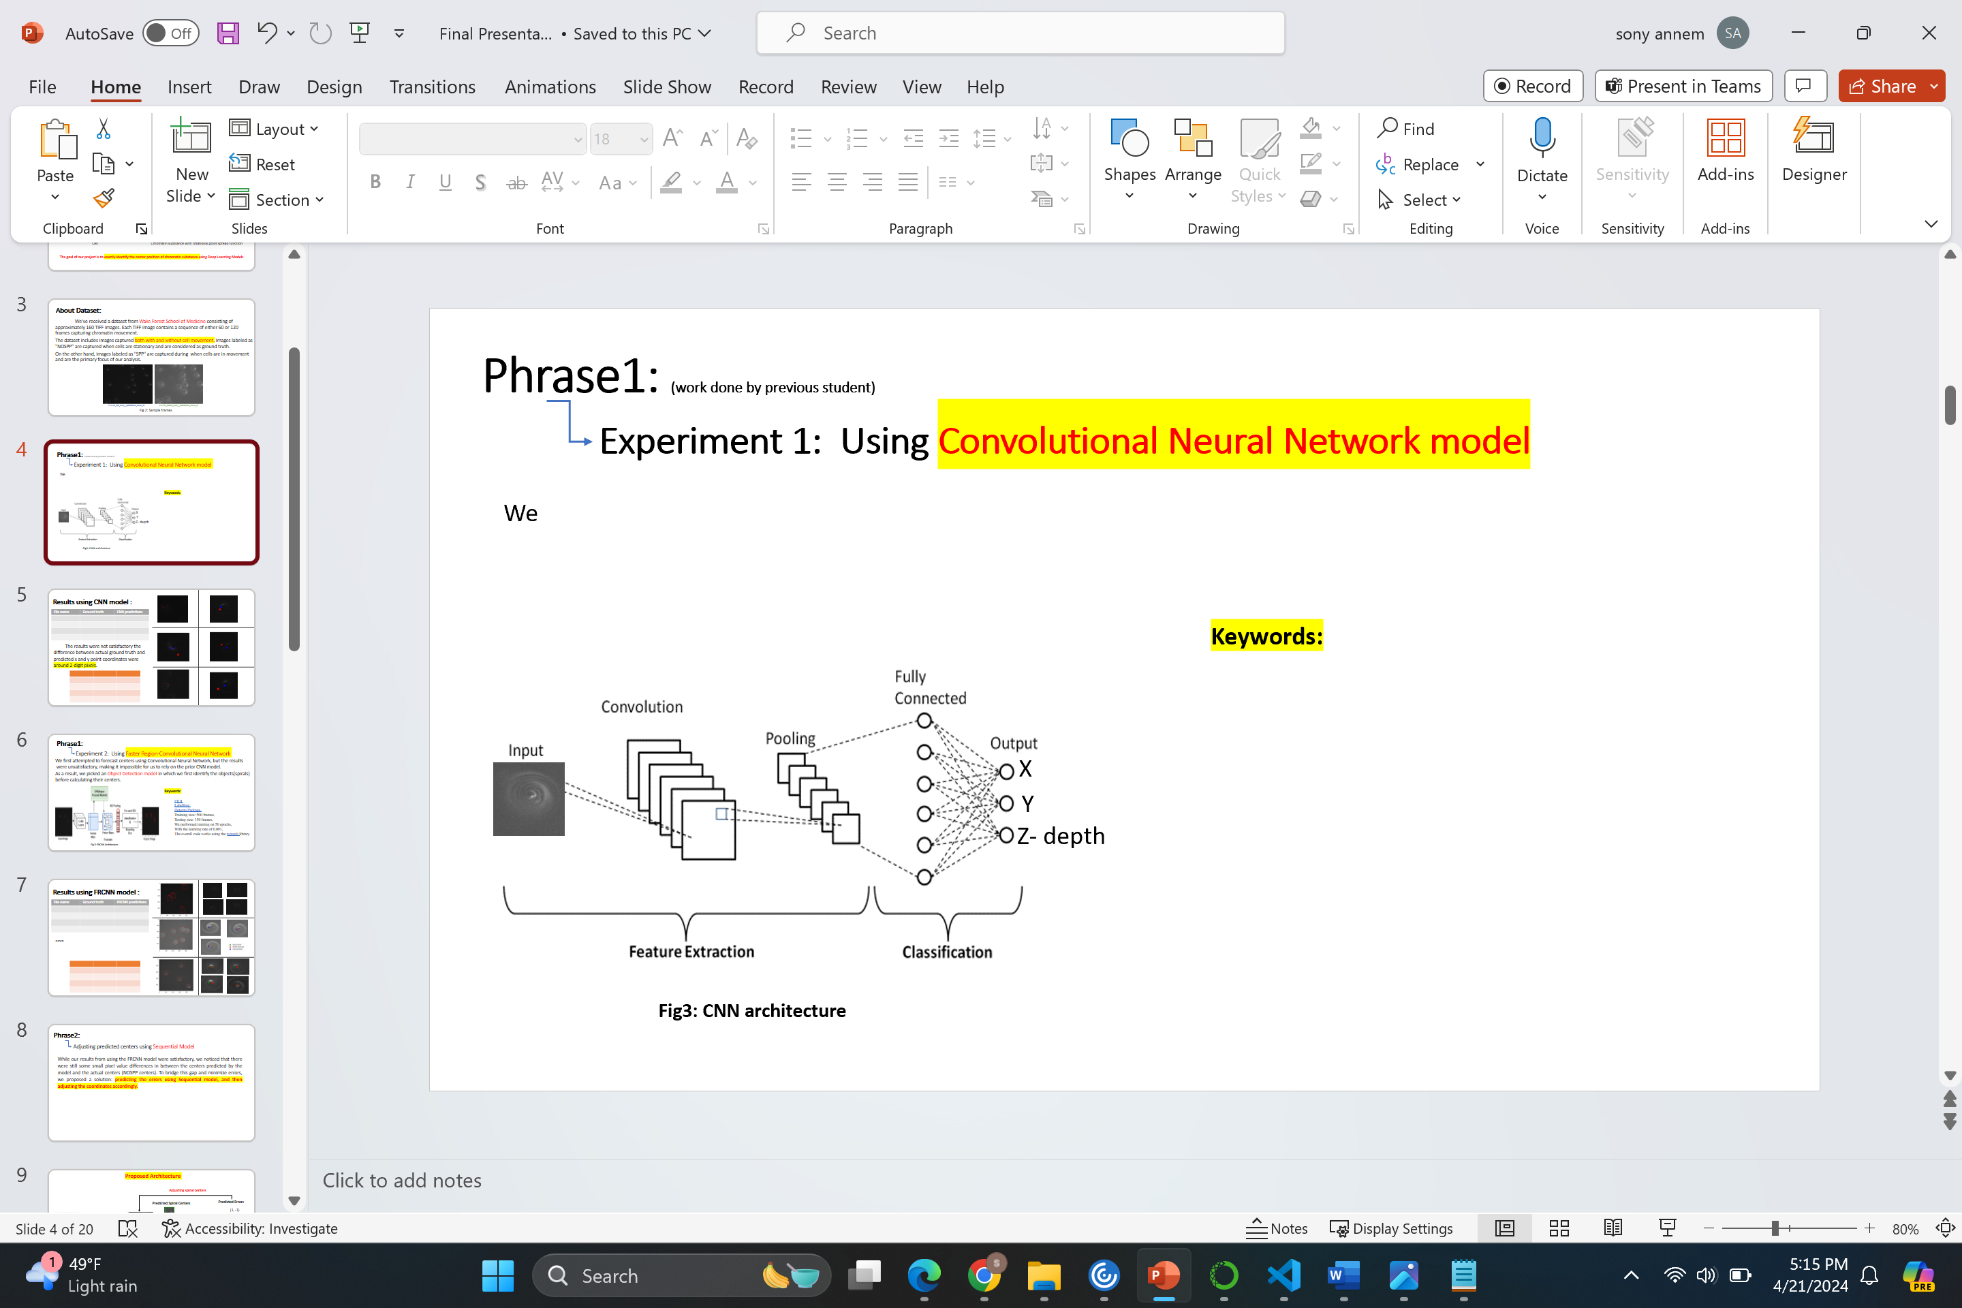
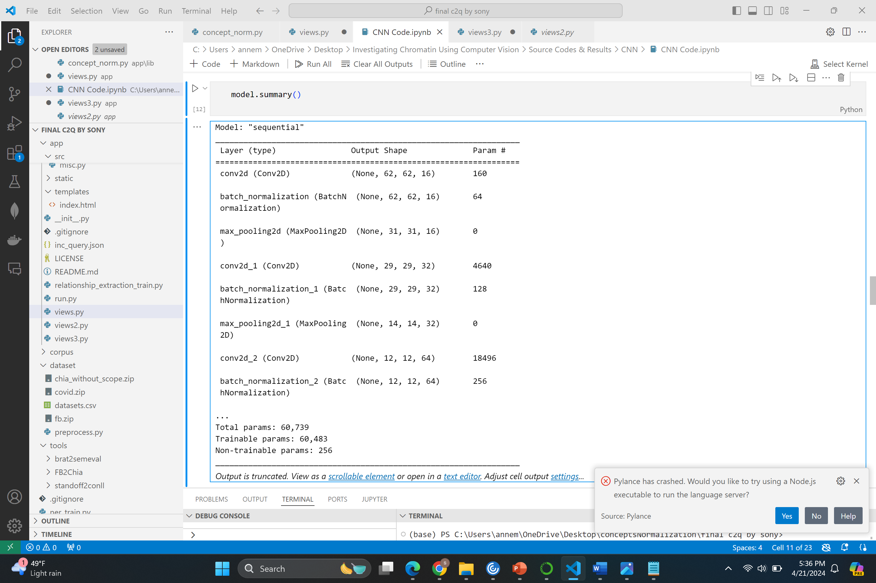
Phrase1: (work done by previous student) Approach 1: Using Convolutional Neural Network model
We passed image patch along with X, Y and Z(depth) point coordinates as input to the CNN.
Keywords: Training size: 100 tiff images, Learning rate 0.01, Epochs : 50, Optimizer : adadelta.
Fig4: CNN architecture
Fig5: Model Summary
Notes:
It is basic cnn with 3 layers of convolutional, 2 layers of max pooling and 3 batch normalization layers, hyper parameters

Slide 6
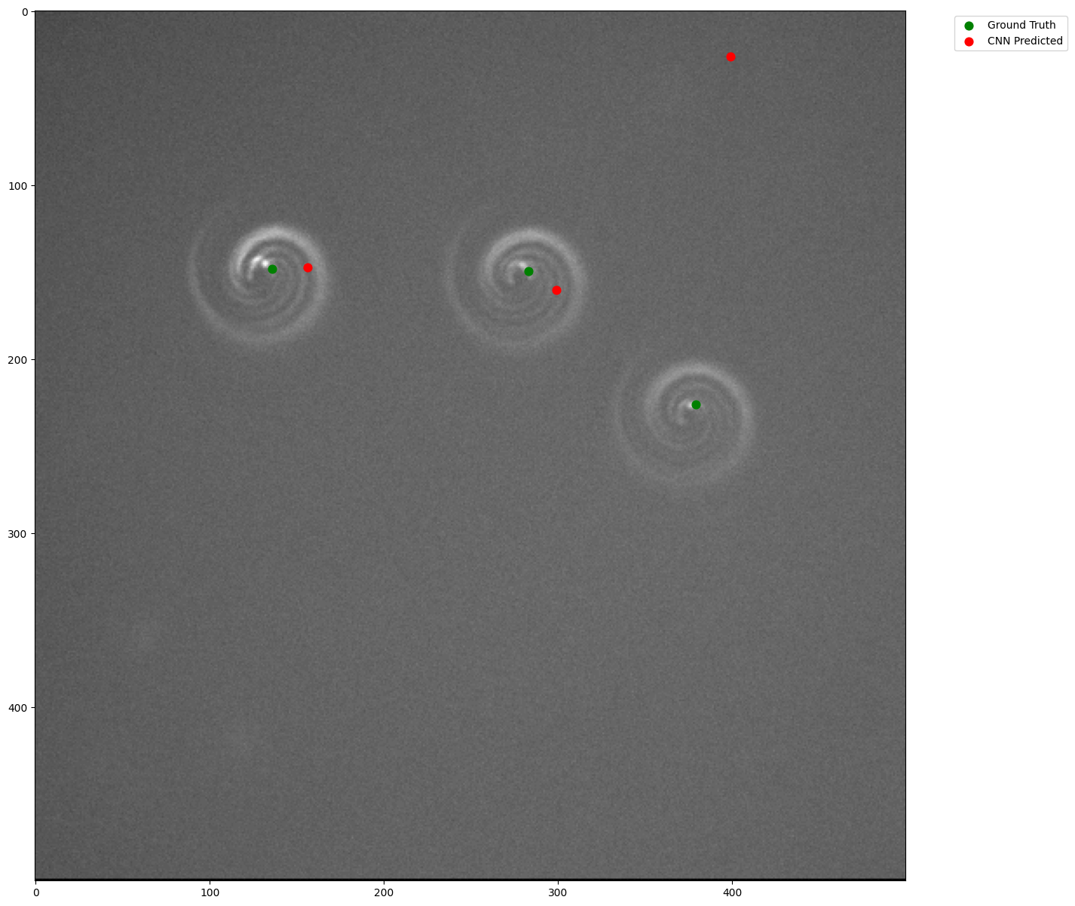
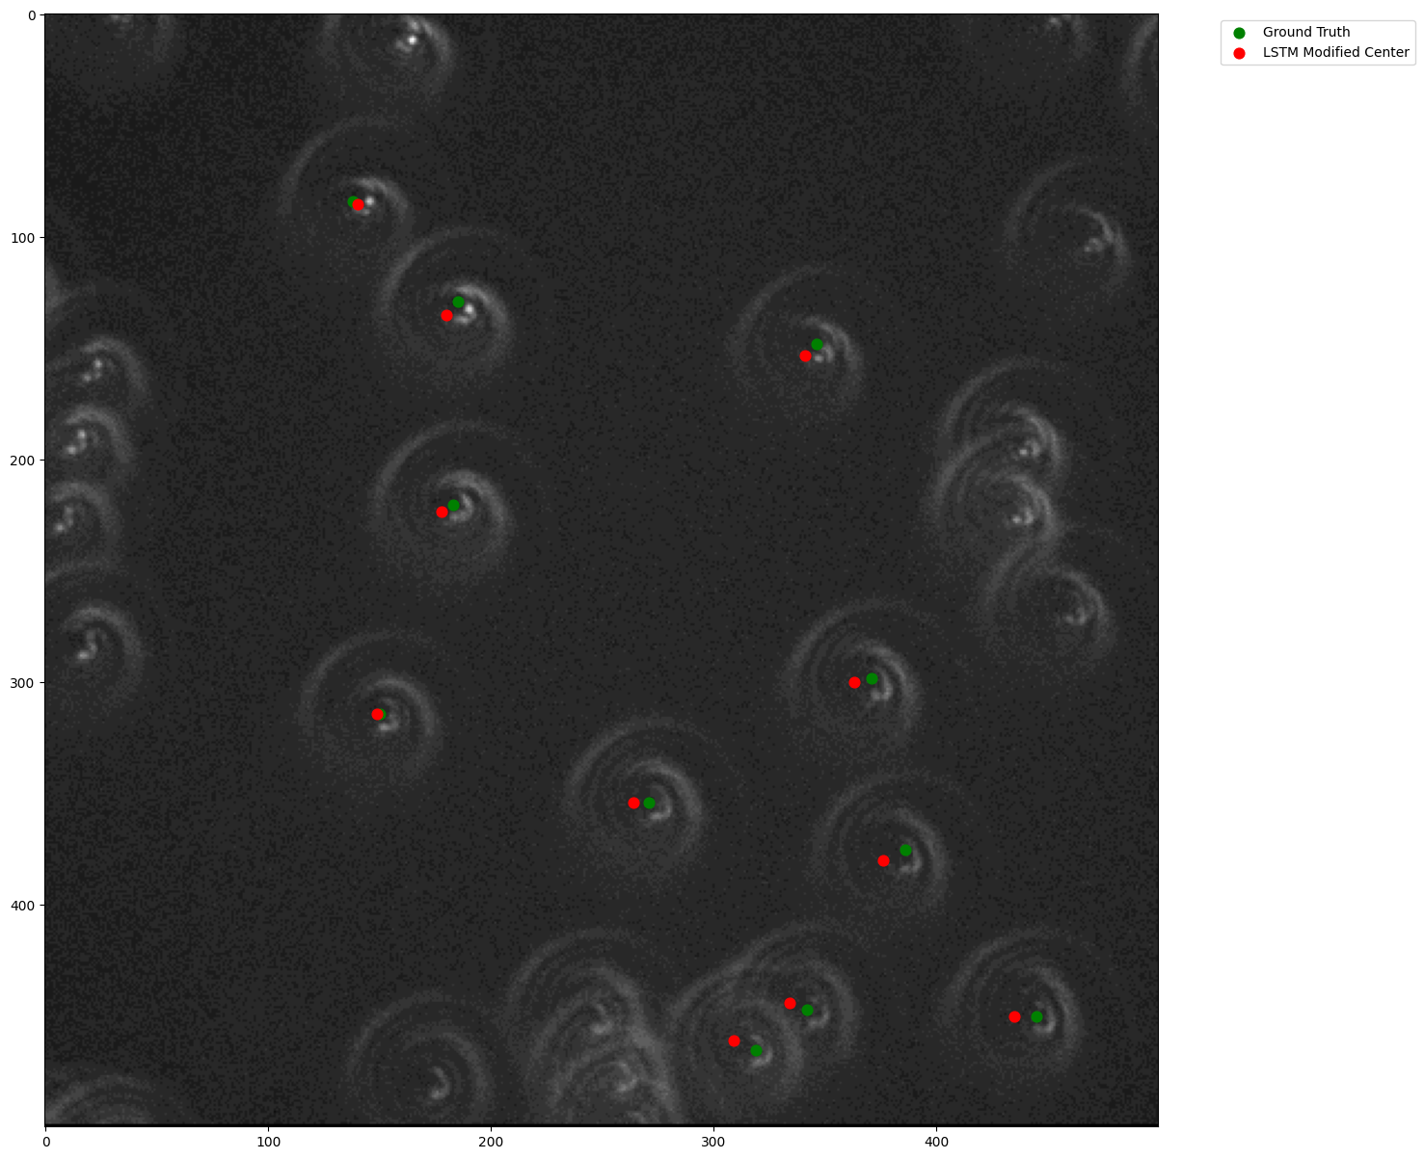
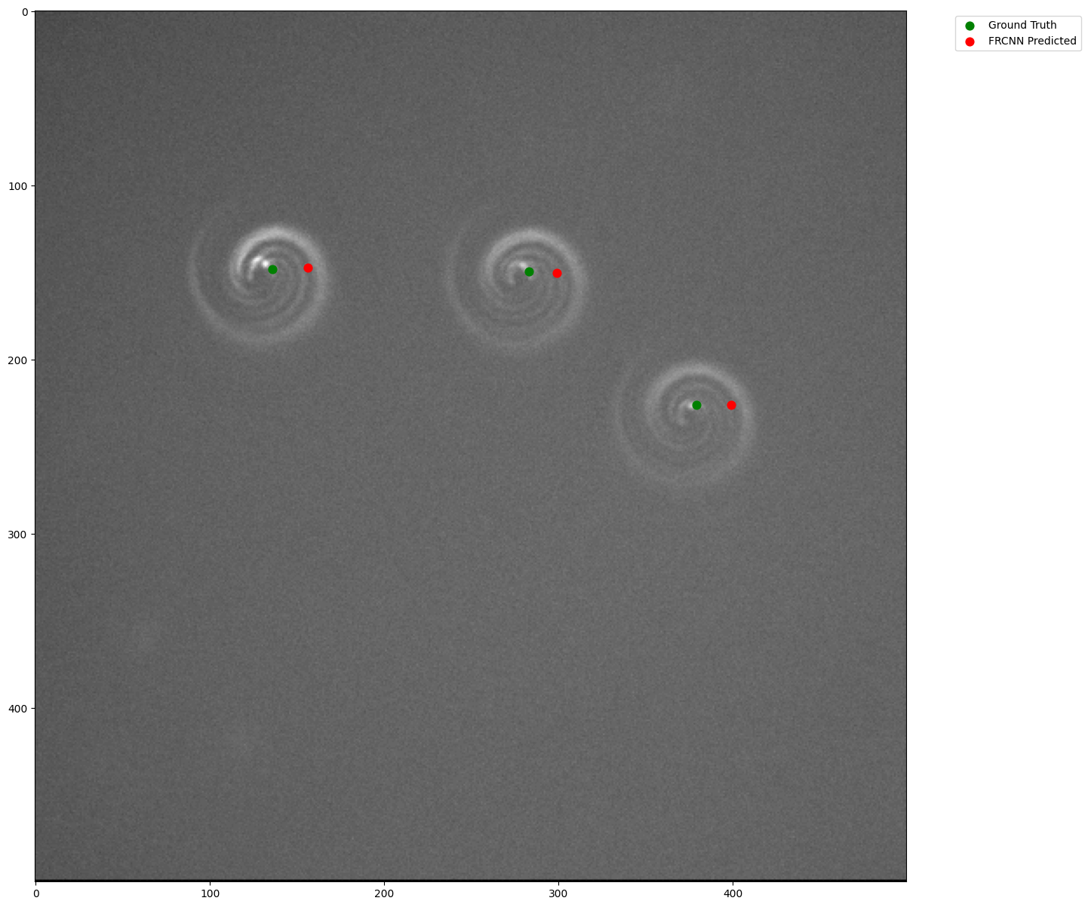
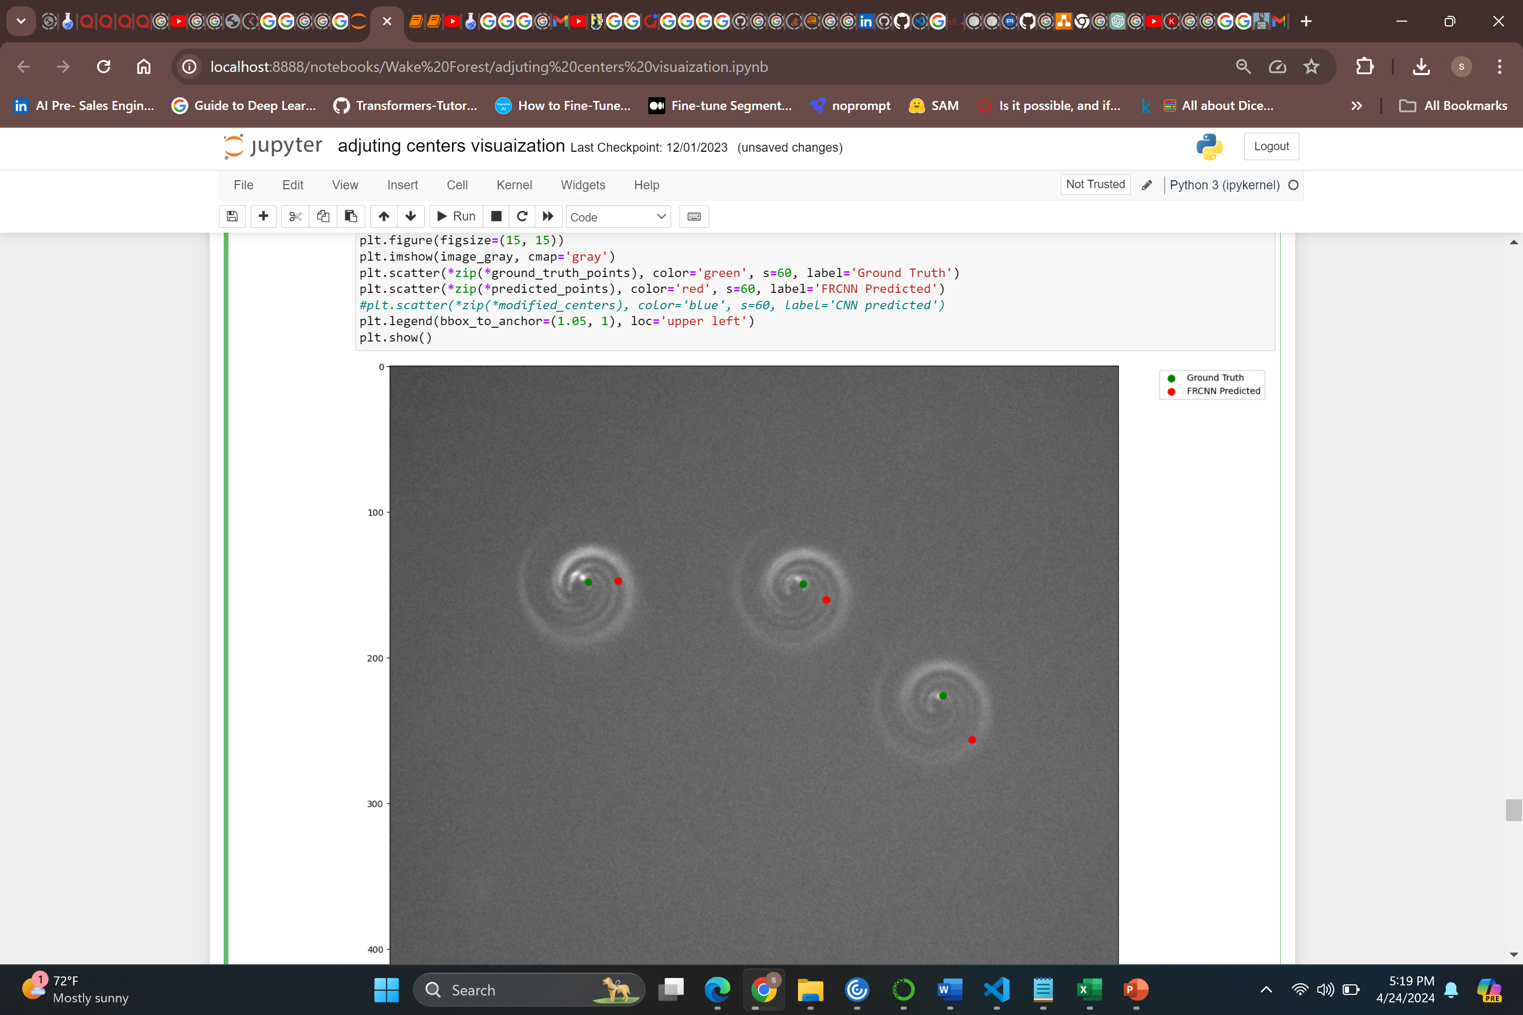
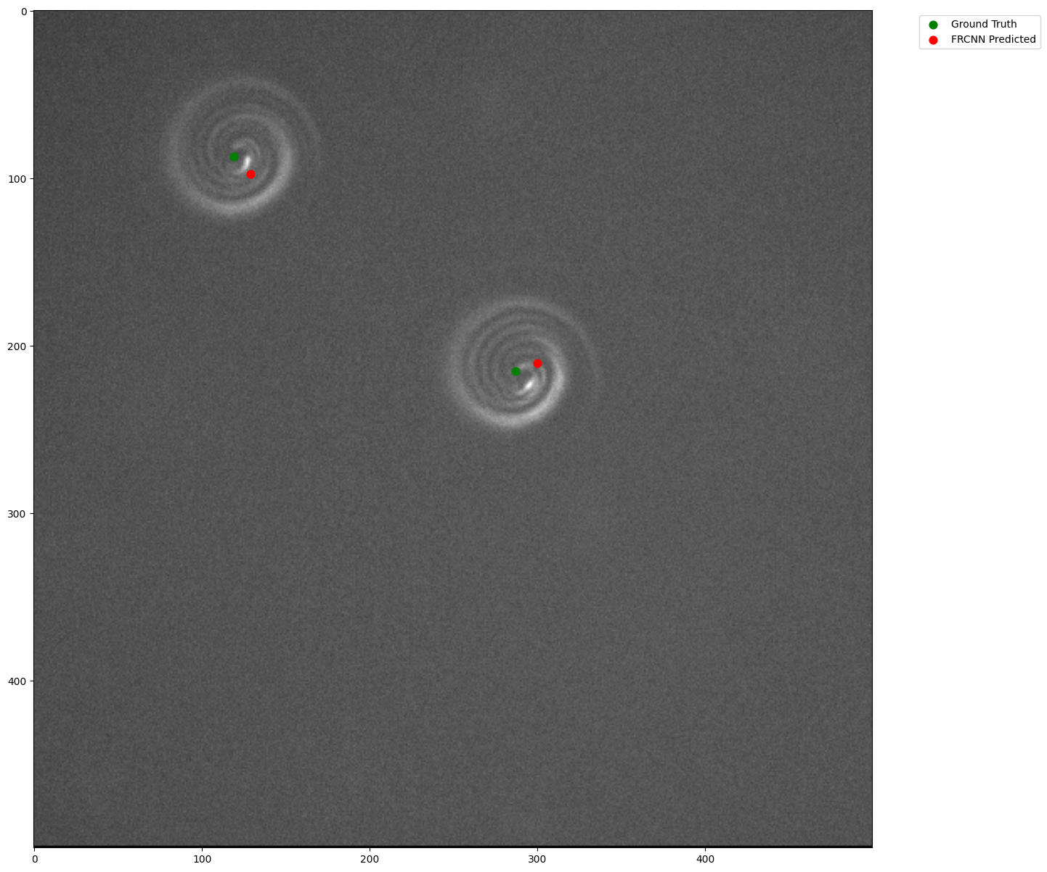
Results using CNN model :
File name | Ground truth | CNN predictions
11.23.21_SPP_Fov2_1_NDTiffStack.tif | (279, 279, 17) | (194, 54, 17)
11.11.21_SPP_Fov2_1_NDTiffStack.tif | (324, 324, 17) | (327, 196, 16)
2.3.22_SPP_Fov2_1_NDTiffStack.tif | (264, 271, 15) | (260, 293, 14)
11.18.21_SPP_Fov2_1_NDTiffStack.tif | (406, 344, 16) | (420, 309, 13)
The results were not satisfactory the difference between actual ground truth and predicted x and y point coordinates were around 2-digit pixels.
File name | Error X | Error Y
11.23.21_SPP_Fov2_1_NDTiffStack.tif | 85 | 225
11.11.21_SPP_Fov2_1_NDTiffStack.tif | -3 | 128
2.3.22_SPP_Fov2_1_NDTiffStack.tif | 4 | -22
11.18.21_SPP_Fov2_1_NDTiffStack.tif | -14 | 35

Slide 7
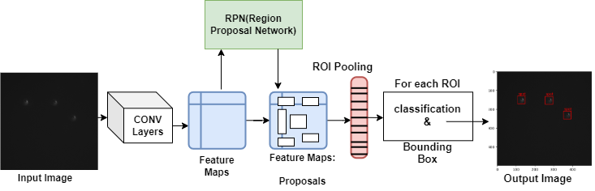
Phrase1: Approach 2: Applying Object Detection Model
We first attempted to forecast centers using Convolutional Neural Network, but the results
were unsatisfactory, making it impossible for us to rely on the prior CNN model.
As a result, we picked an Object Detection model called Faster R-CNN in which we first identify
the objects(beads) before calculating their centers.
Keywords:
FIJJI
LabelImg.
Detecto Package. (to create custom model)
Training size: 500 images,
Testing size: 150 images,
We performed training on 50 epochs with
learning rate of 0.001,
The overall code works using pytorch library.
Training Accuracy: 0.67
Fig 6: Faster R-CNN Architecture

Slide 8
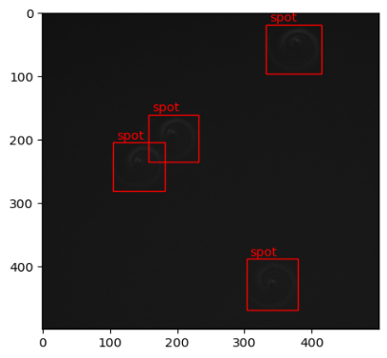
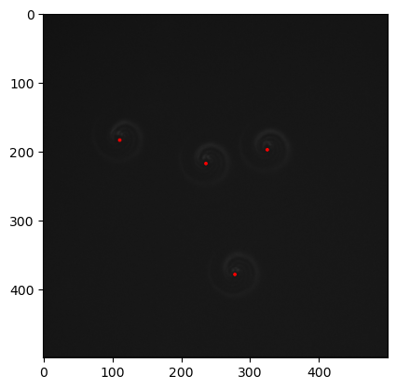
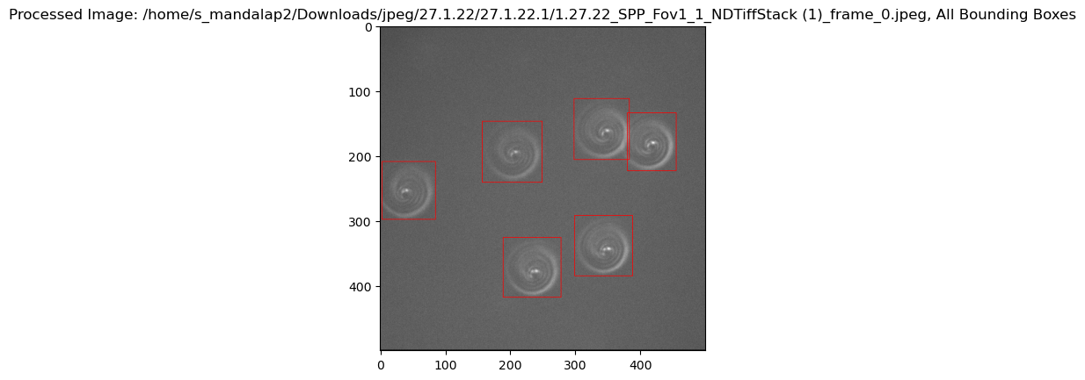
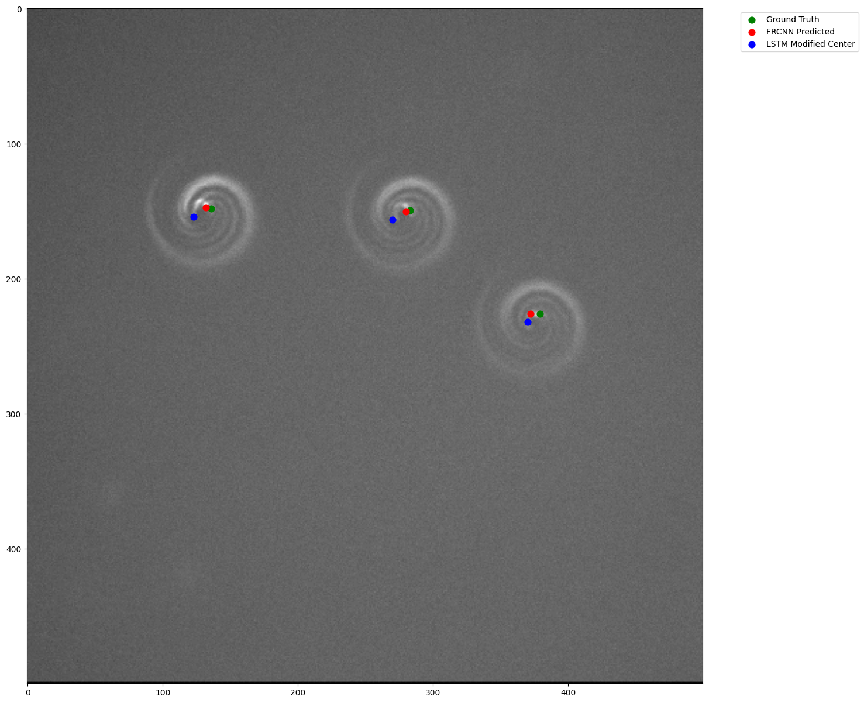
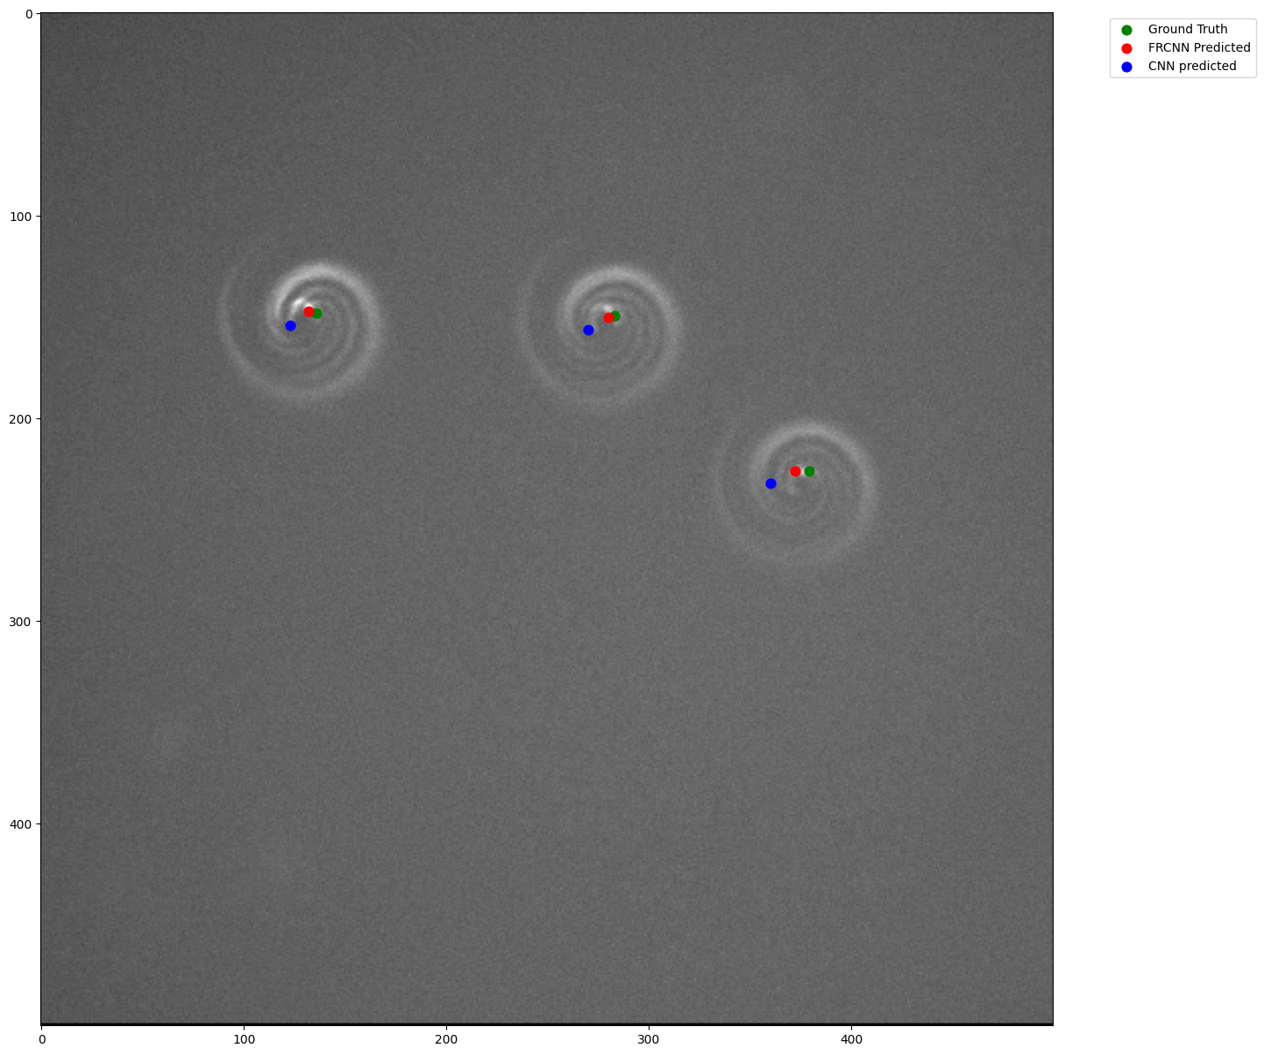
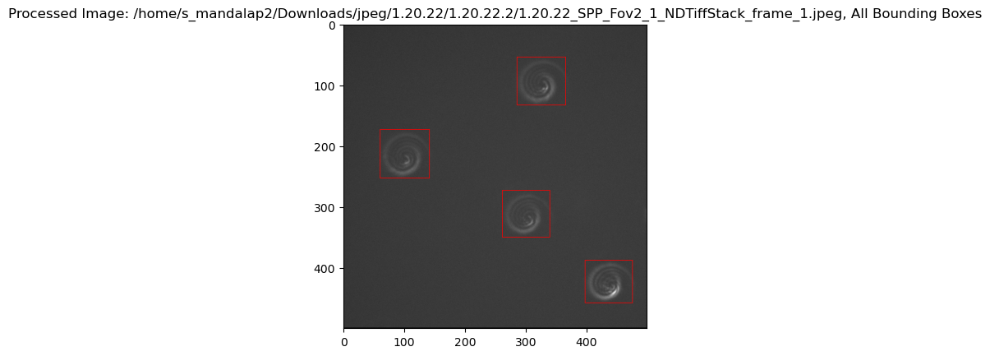
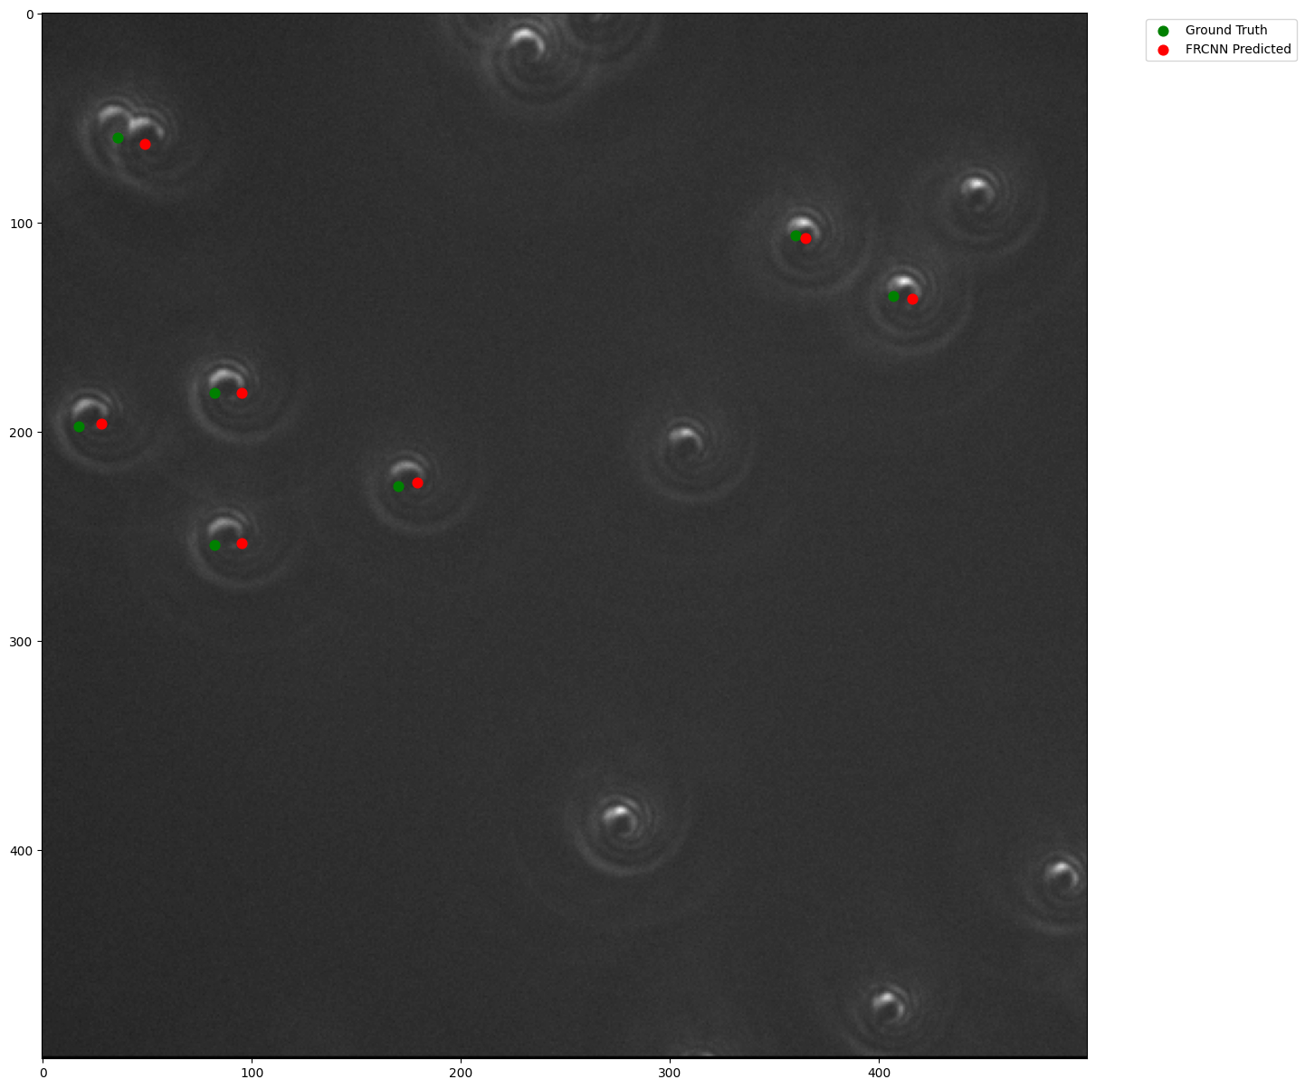
Results using Faster R-CNN model :
File name | Ground truth | FRCNN predictions
1.20.21_SPP_Fov1_1_NDTiffStack.jpeg | (290, 352) | (291, 347)
1.11.21_SPP_Fov4_1_NDTiffStack.jpeg | (42, 225) | (47, 220)
2.3.22_SPP_Fov5_1_NDTiffStack.jpeg | (264, 271) | (260, 271)
11.18.21_SPP_Fov3_1_NDTiffStack.jpeg | (406, 344) | (410, 344)
Centerx: xmin+(xmax-xmin//2)
Centery: ymin+(ymax-ymin//2)
xmin, ymin
xmax, ymax
Average Errors
FileName | AverageXError CNN | AverageXError FRCNN | AverageYError CNN | AverageYError FRCNN
11.18.21_SPP_Fov3_1_NDTiffStack.tif | 15.33 | -1 | 7.8 | 5.0
11.30.21_SPP_Fov8_1_NDTiffStack.tif | -16.0 | -5 | 20.3 | 5
2.3.22_SPP_Fov1, 3, 4_1_NDTiffStack.tif | 12.4 | 4.6 | 13.9 | 9.3
11.23.21_SPP_Fov2_1_NDTiffStack.tif | 8.6 | -2.5 | 14.16 | 4.6
11.2.21_SPP_Fov3_1_NDTiffStack.tif | -0.3 | -3.8 | 34.33 | 4.1

Slide 9
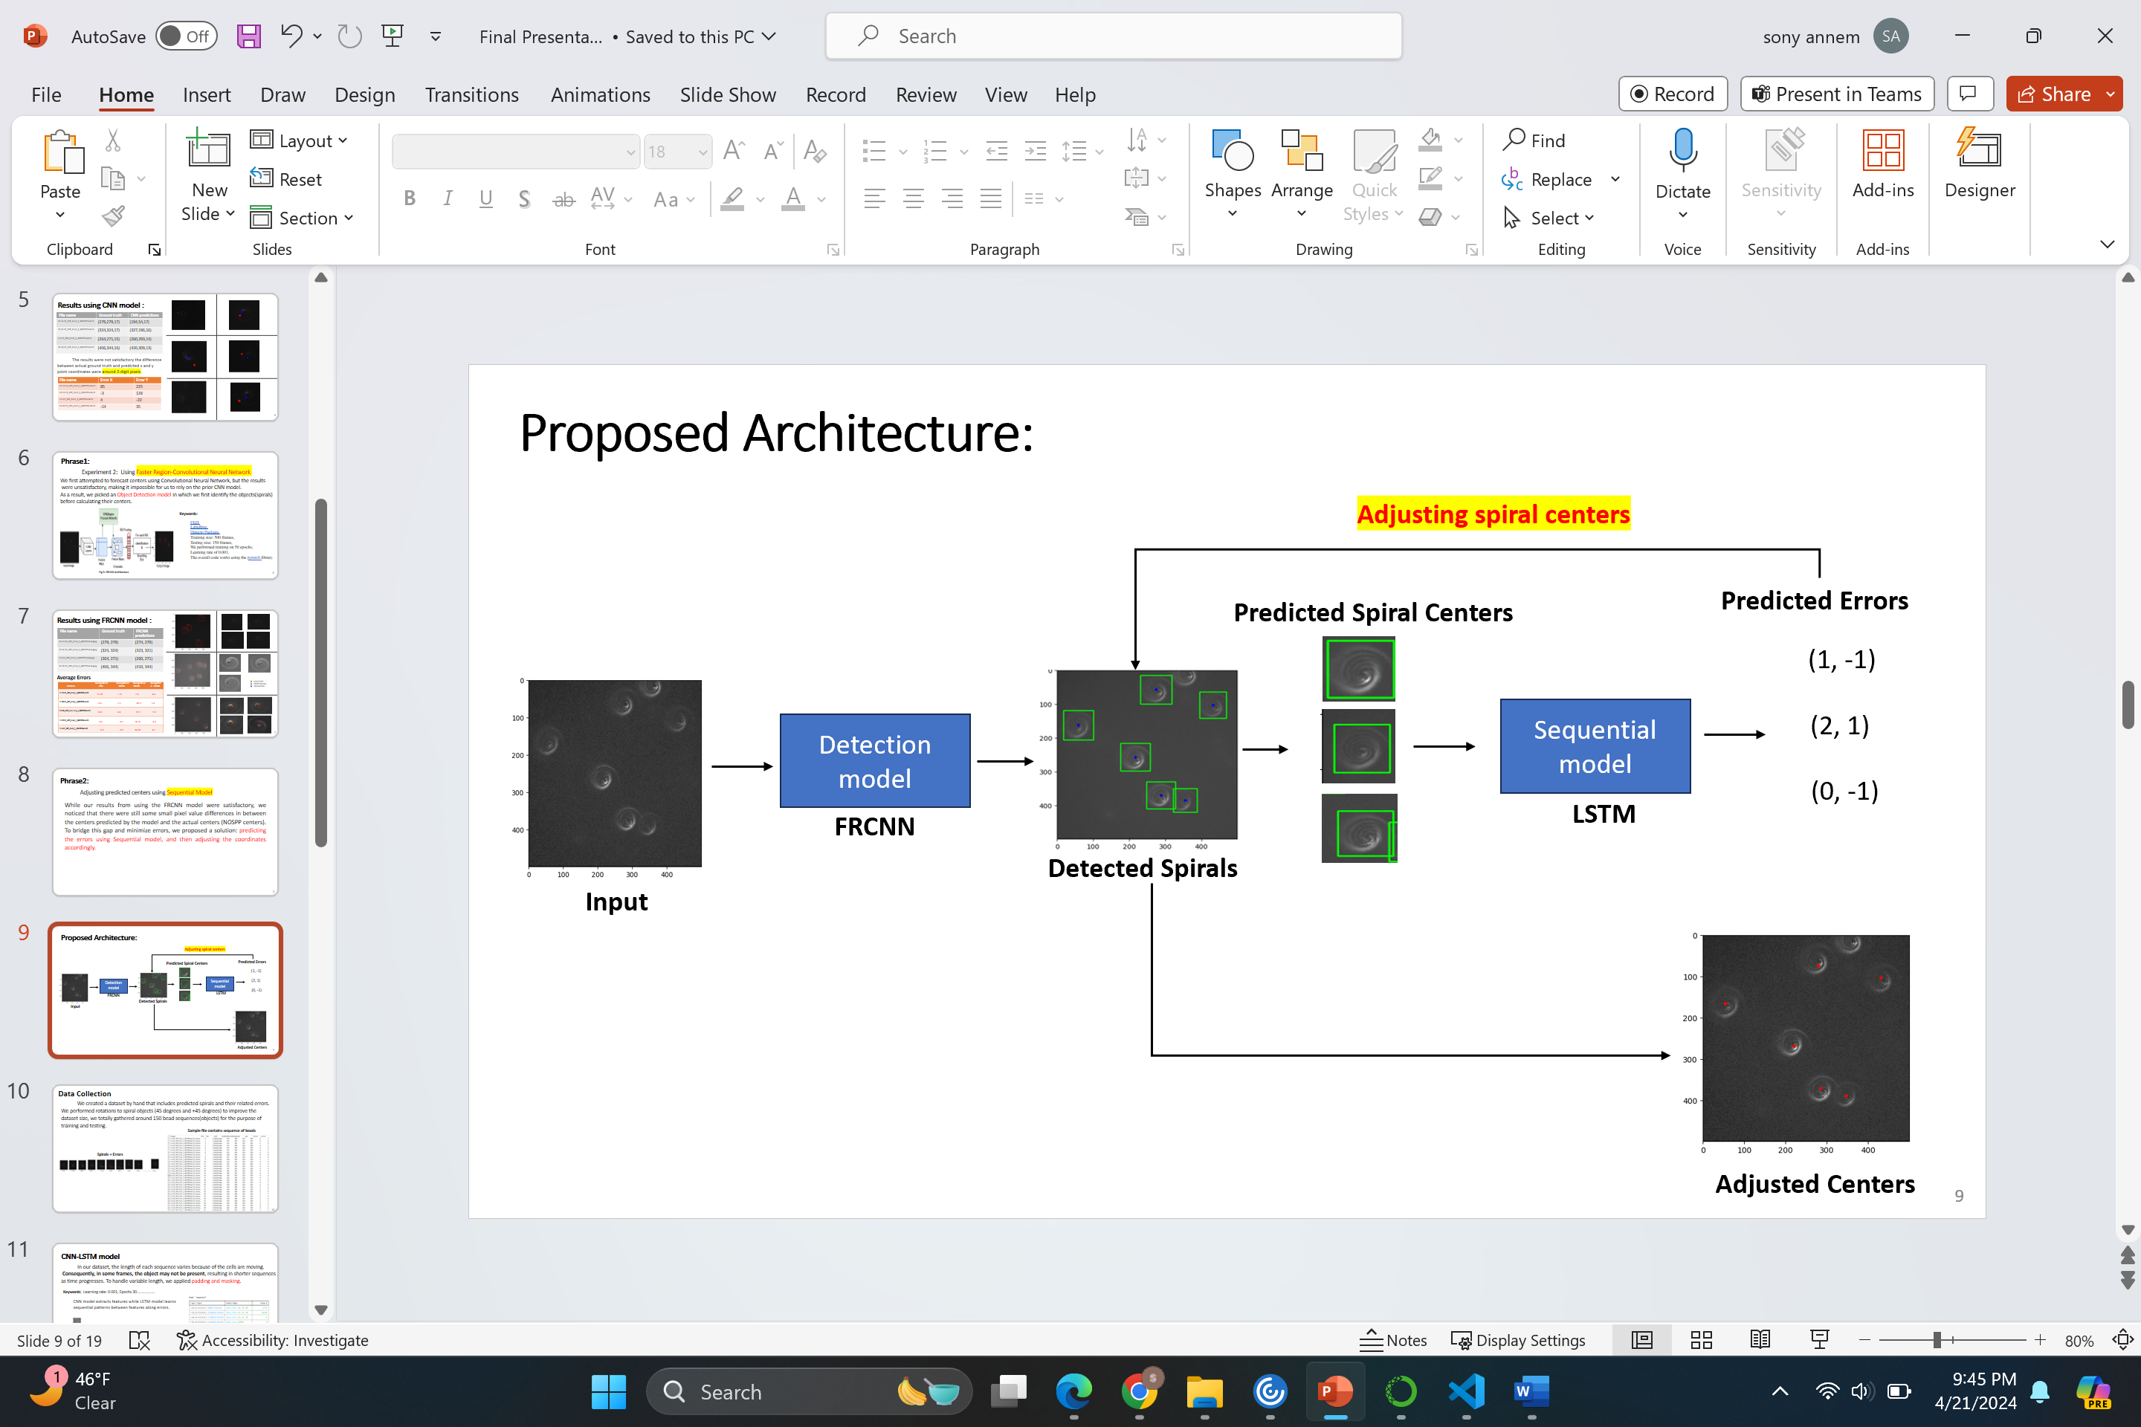
Phrase2:
Adjusting predicted centers using Sequential Model
To bridge this gap and minimize errors;
we proposed a solution: predicting the errors using Sequential model, and then adjusting the coordinates accordingly.
Notes:
While our results from using the FRCNN model were satisfactory, we noticed that there were still some small pixel value differences in between the centers predicted by the model and the actual centers (NOSPP centers). To bridge this gap and minimize errors, we proposed a solution: predicting the errors using Sequential model, and then adjusting the coordinates accordingly.
Temporal features, spatial feature…predicting errors, based on errors, LSTM model because of data is sequential as each frame is moving some direction from the focal point

Slide 10
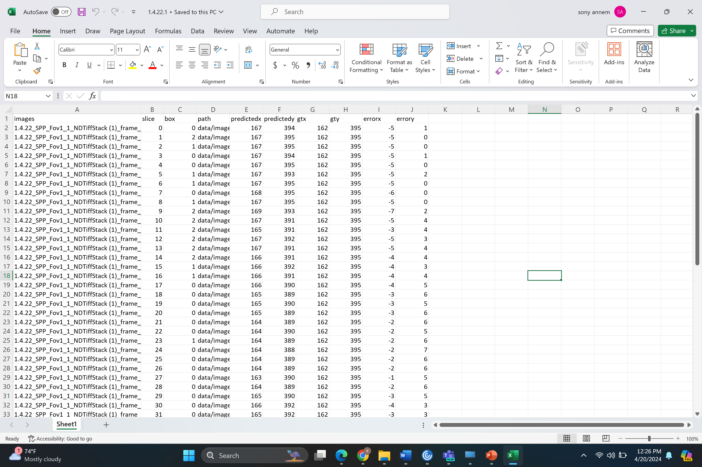
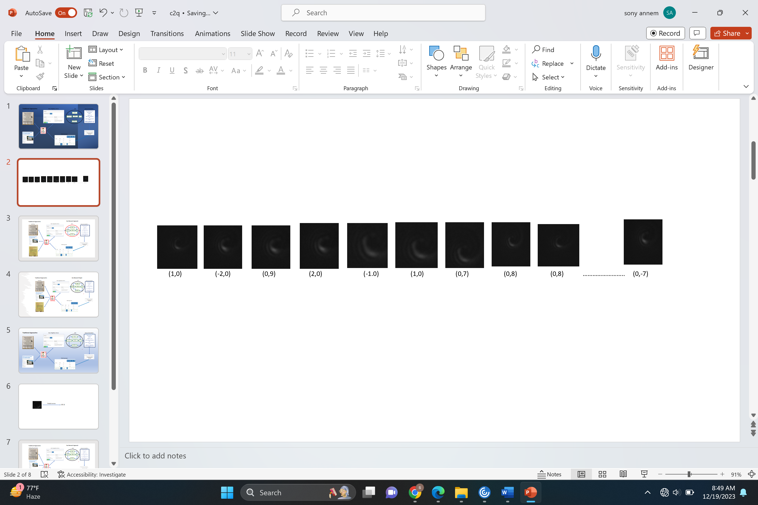
Data Collection:
We created a dataset by hand that includes predicted spirals and their related errors. We performed rotations to spiral objects (+45 degrees and -45 degrees) to improve the dataset size, we totally gathered around 150 unique bead sequences for the purpose of training and testing.
Fig7: Sample file contains sequence of beads
Spirals + Errors

Slide 11
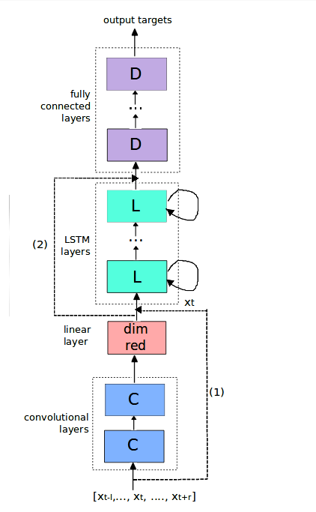
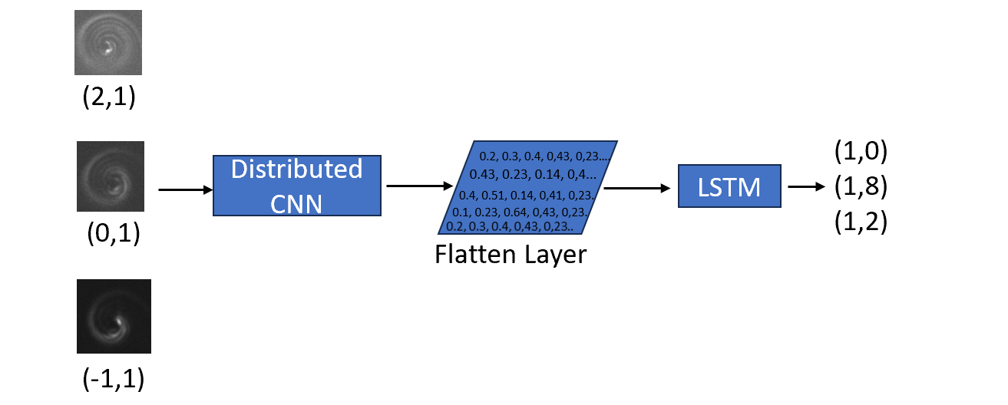
CNN-LSTM model:
In our dataset, the length of each sequence varies because of the cells are moving.
Consequently, in some frames, the object may not be present, resulting in shorter sequences
as time progresses.
To handle variable length, we applied padding and masking.
Masking layer ignore padded time steps during training.
Error: (2,1)
Keywords: Learning rate: 0.001, Epochs: 30 with early Stopping , batch size: 1 , time stamp=None
Fig8: wrap each layer in the CNN model in a TimeDistributed layer
Notes:
We used time distributed cnn it wraps the sequnces of images and our chroman substances is moving so the firt frames beads present in the edges might not present in time progresses.so to handle variable length we implemented padding and masking techquie.. Masking helps lstm to ignore padded values during training.

Slide 12
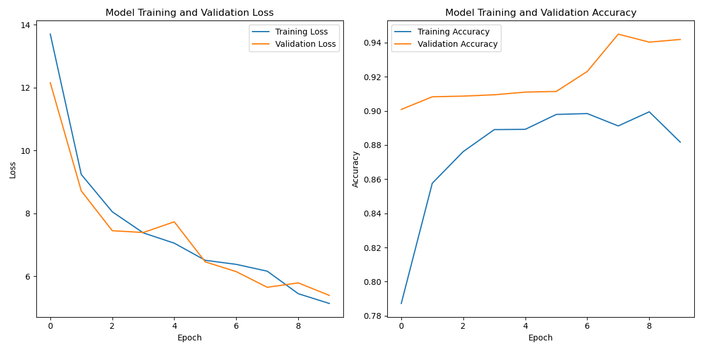
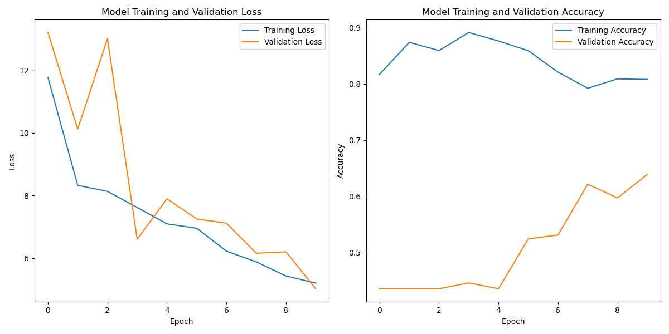
Evaluation metrics:
We performed 5-fold cross validation to check the performance; the interesting thing is simple architecture of TimeDistributed CNN-LSTM plays a promising role in predicting errors.
Cross Validation-1
Cross Validation-3
Training | 99 bead sequences
Validation | 1.27.22 & 1.4.22(18 bead sequences)
Testing | 11.18.21(12 bead sequences)
Training | 97 bead sequences
Validation | 1.18.21 & 1.4.22(18 bead sequences)
Testing | 1.20.22(15 bead sequences)

Slide 13
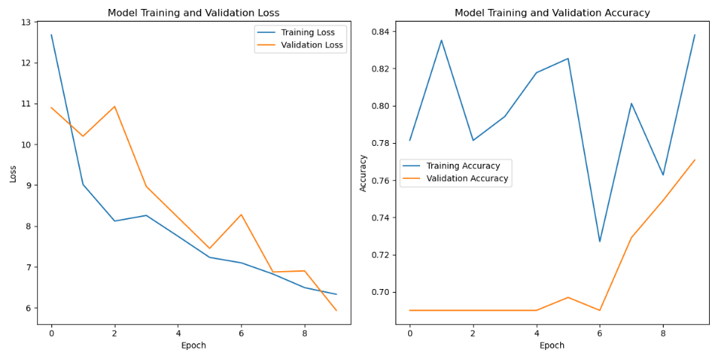
Cont..
Cross Validation-5
Training | 106 bead sequences
Validation | 1.27.22 (9 bead sequences)
Testing | 12.2.21(5 bead sequences)
Average Scores of 5-fold CV :
AVG training loss | 4.4 mse
AVG Validation loss | 5.7 mse
AVG training Accuracy | 79 %
AVG validation Accuracy | 78.4 %

Slide 14
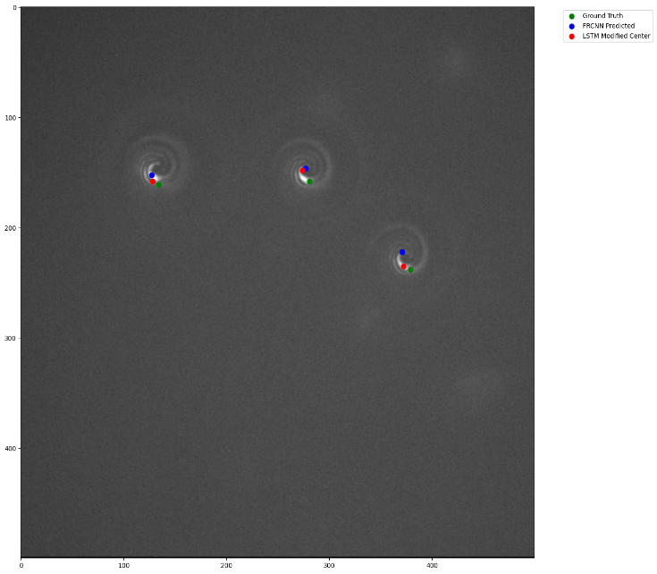
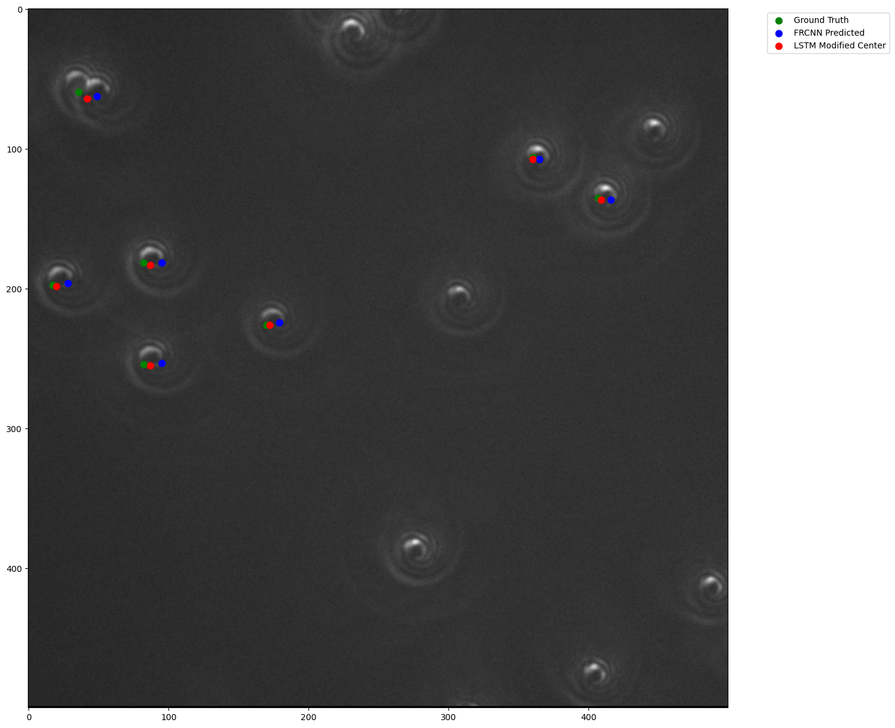
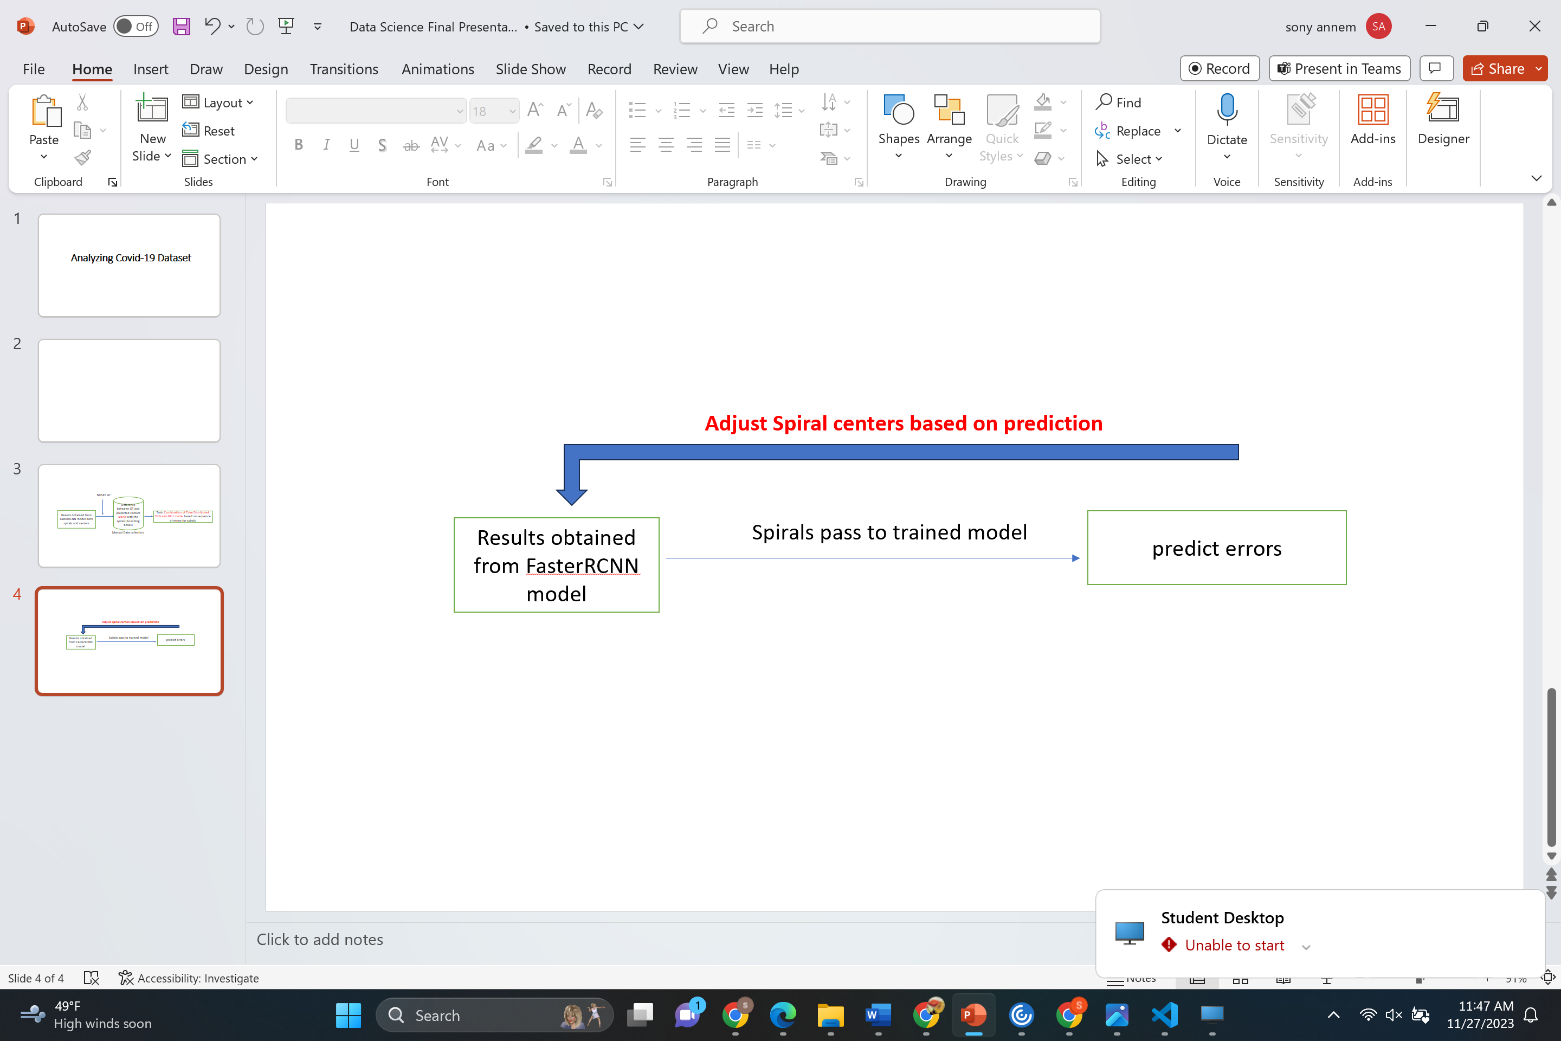
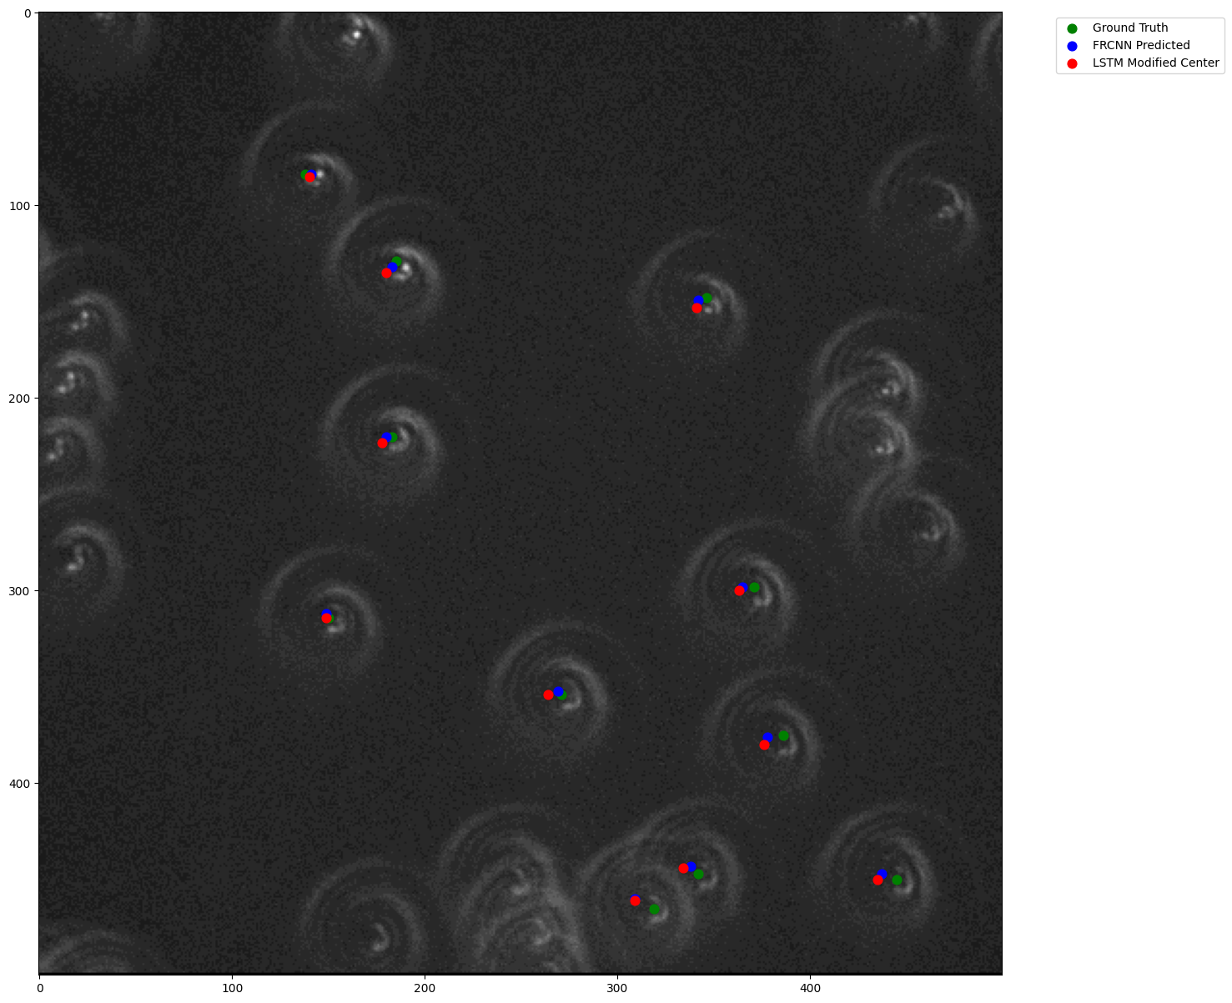
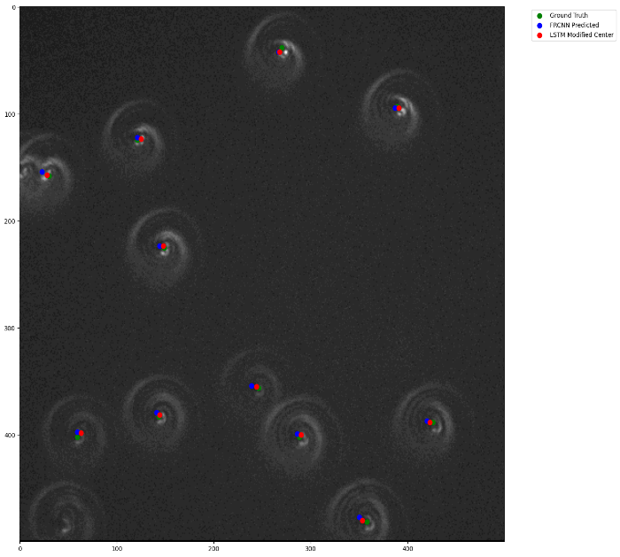
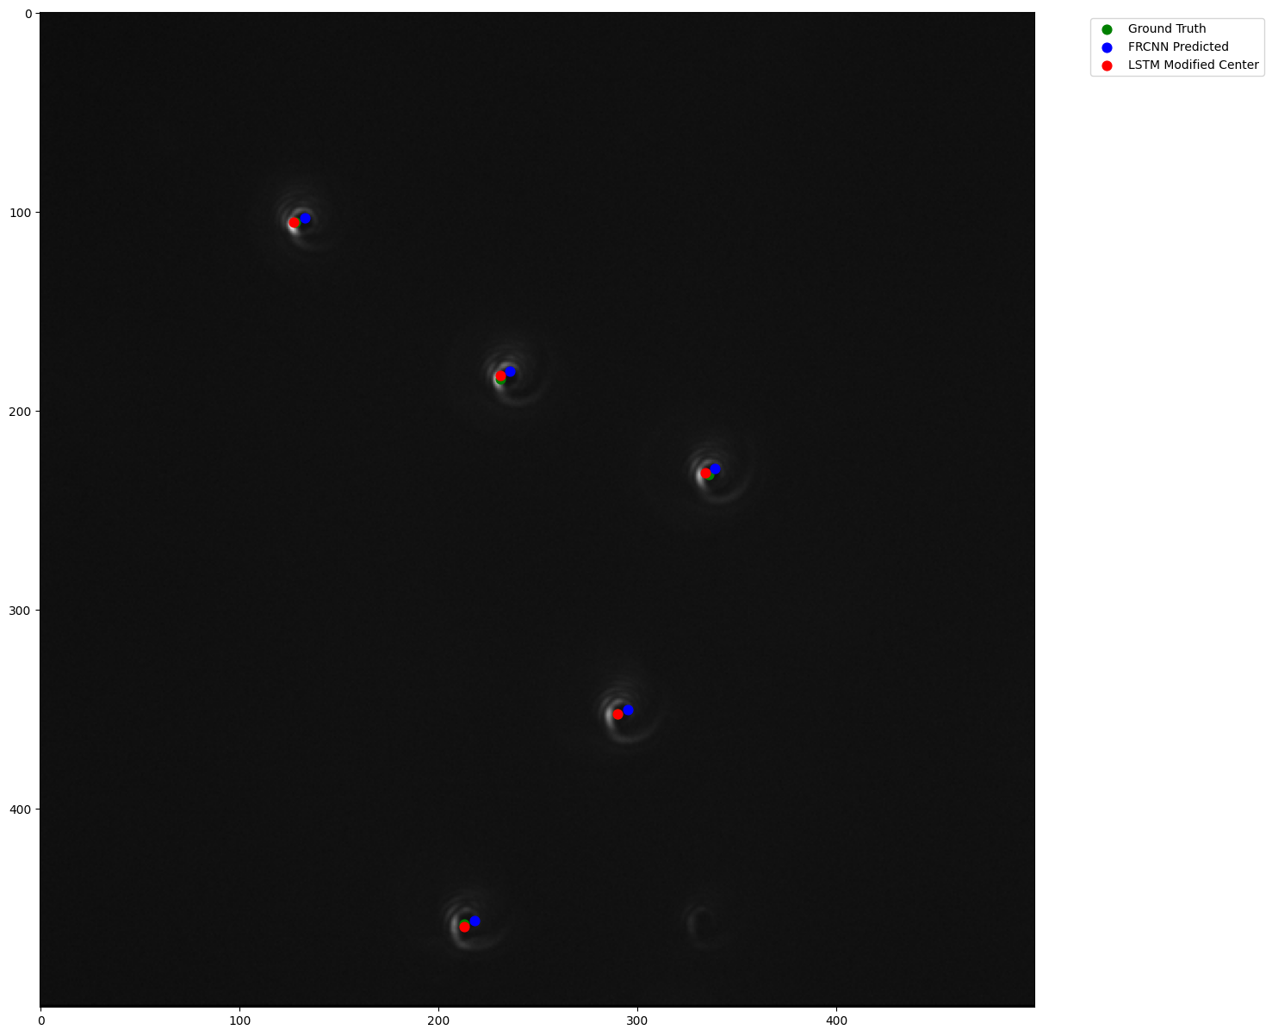
Results after Adjustment:
Average Errors Comparison:
Files | Average FRCNN X error | Modified Average X error | Average FRCNN Y error | Modified Average Y error
11.18.21.1 | 6.2 | 4.2 | 4.1 | 0.6
11.18.21.2 | 6.7 | 4.8 | 3.2 | 1.9
11.18.21.3 | 7.0 | 3.2 | 3.6 | 0.8
11.18.21.4 | 6.3 | 3.5 | 4.4 | 0.7
11.18.21.5 | 5.1 | 1.9 | 4.2 | 0.5
11.18.21.8 | 6.0 | 2.7 | 3.5 | 0.6
11.18.21.10 | 3.0 | 1.3 | 5.6 | 1.8
11.18.21.12 | 4.6 | 1.5 | 1.5 | 1.9
11.18.21.11 | 6.0 | 2.4 | 2.4 | 1.7

Slide 15
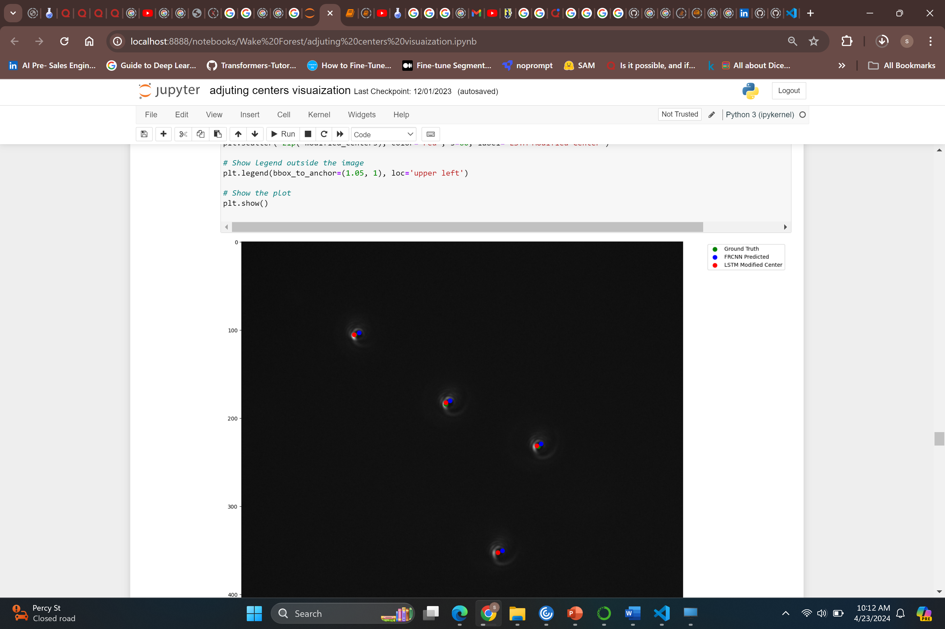
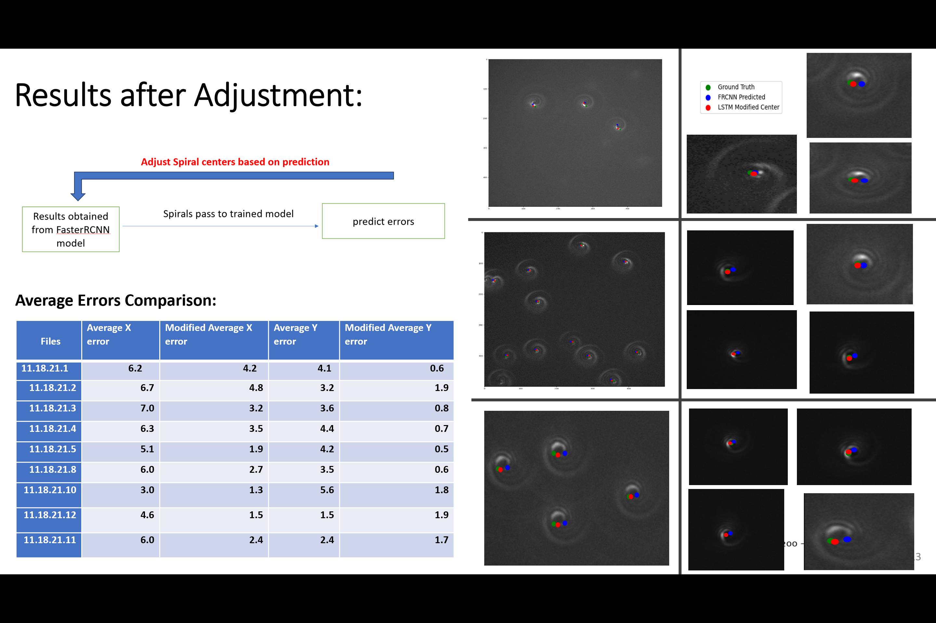
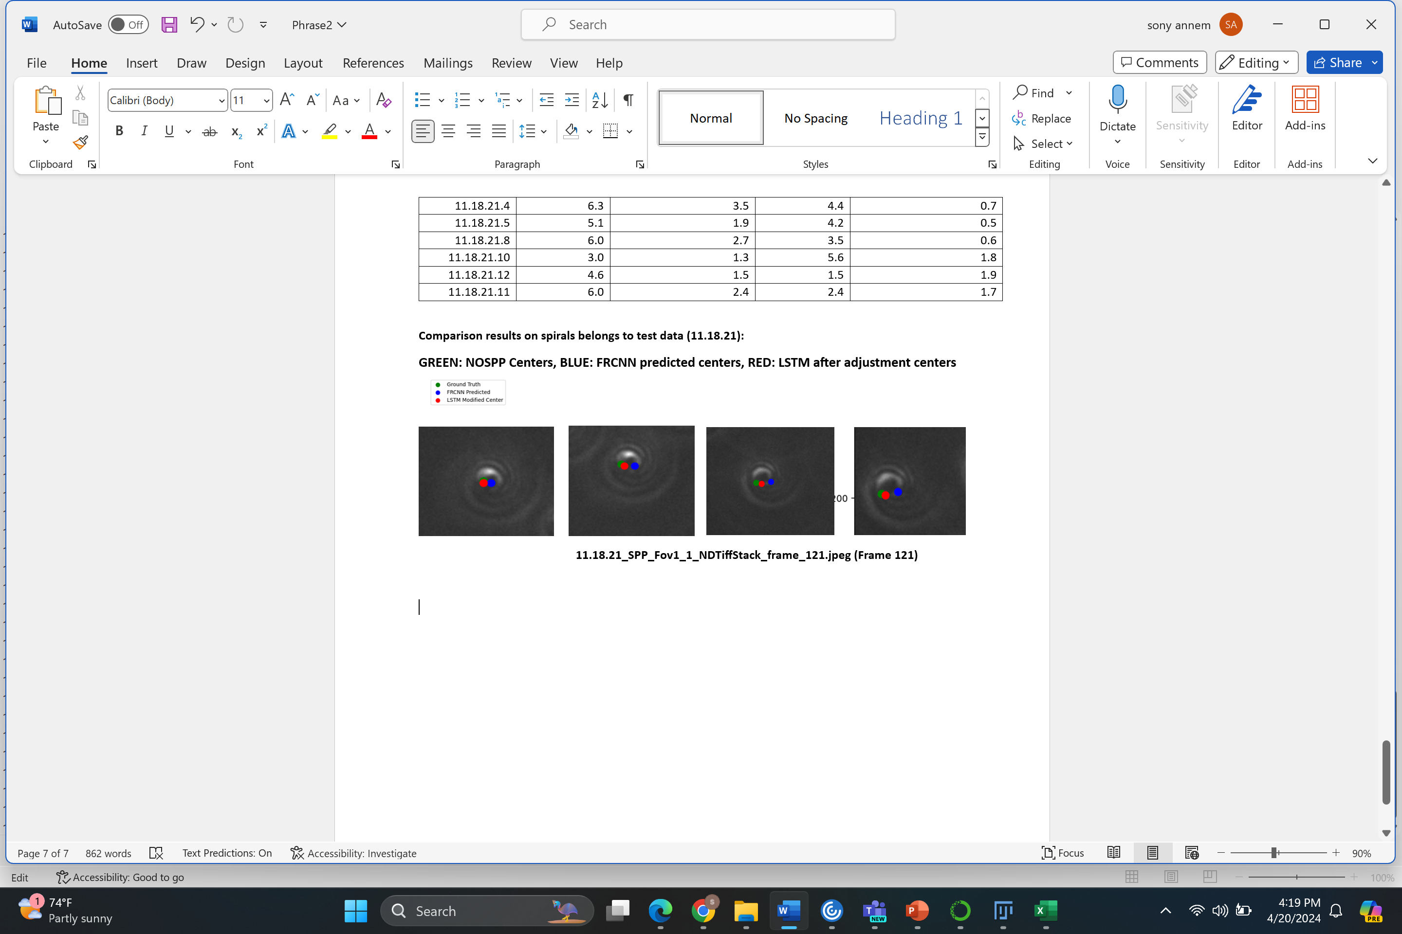
Cont..
11.1121_SPP_FOV1_1_NDTiffStack_frame_121.jpeg
Notes:
Created a custom model using detecto

Slide 16
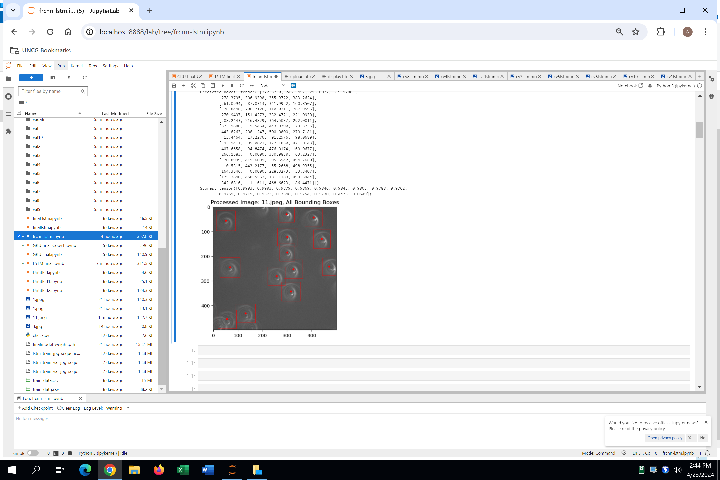
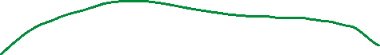






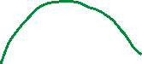




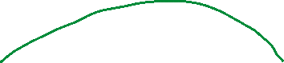
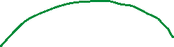


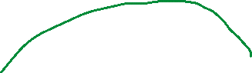





Future Work:
1. We observed that it’s hard to detect the dim(dull)
spirals so we are planning to update to MaskRCNN.
2. Coming to LSTM model, here each time step depends on
the before images so we are planning to change the order.
Present :
Future Work :
Notes:
To move towards mask rcnn apply segmenatation than bounding boxes

Slide 17
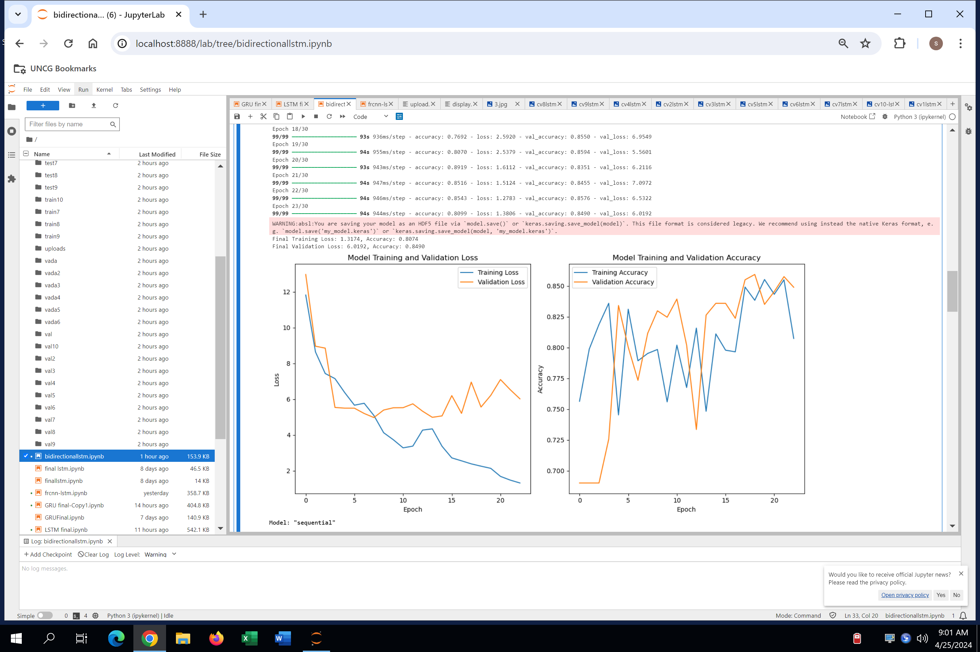
1. CNN-GRU The GRU architecture produced results similar to those of the LSTM model when applied to our dataset. 2. CNN-Bidirectional LSTM
Cont..
1-fold cv results using bi-directional LSTM
We just tried Bidirectional LSTM on 1-fold cross validation
we observed that results were improved compared to Vanilla LSTM. We need to compare with by doing all the 5-fold cross validations.
Notes:
We need to improve the epochs

Slide 18
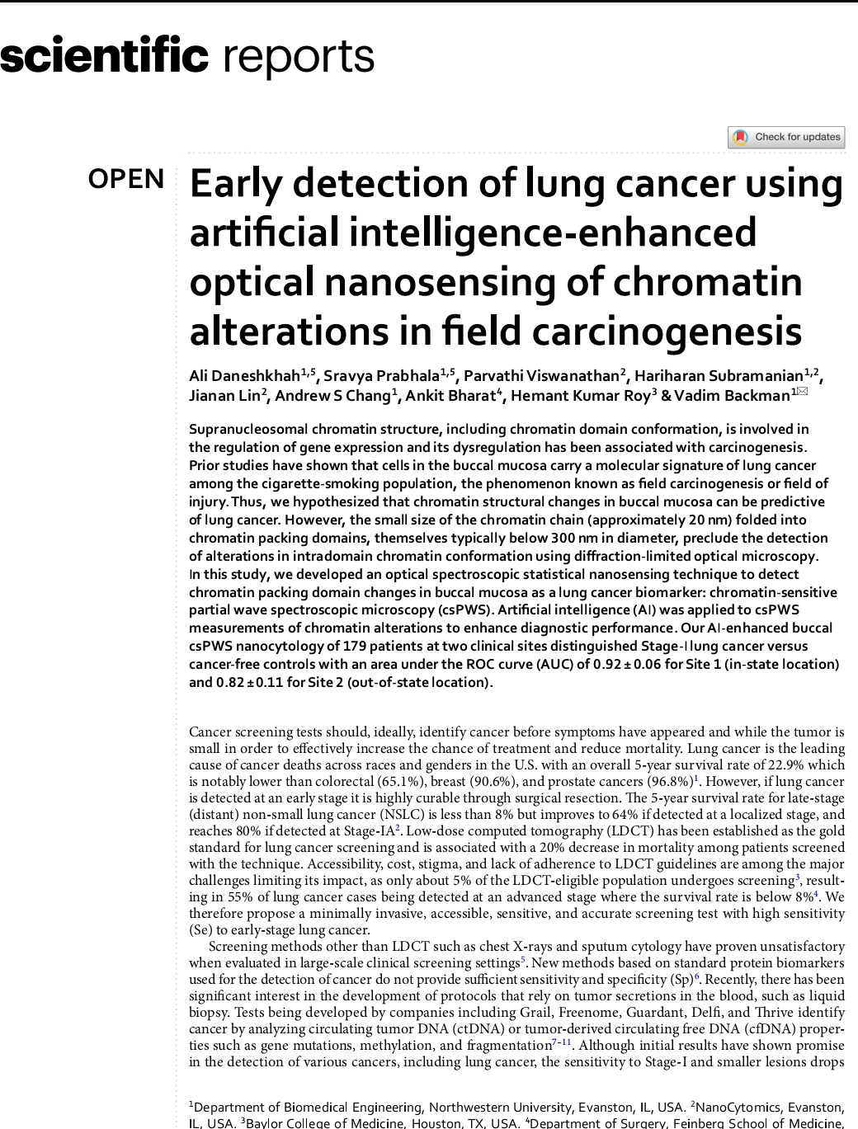
Conclusion:
In conclusion, identifying chromatin centers is crucial and very challenging.
Chromatin plays a fundamental role in regulating gene expression, DNA replication, and repair.
Our Deep Learning methods showed promising results, although there is still room for improvement. Looking ahead, our aim is to achieve perfect accuracy in predicting the chromatin centers. In future we will accurately predict the chromatin centers with 0 error.

Slide 19
Thank you so much Dr.Kim & Dr.Sun
For your support in my entire Master’s program

Slide 20
Other Experiment

Slide 21
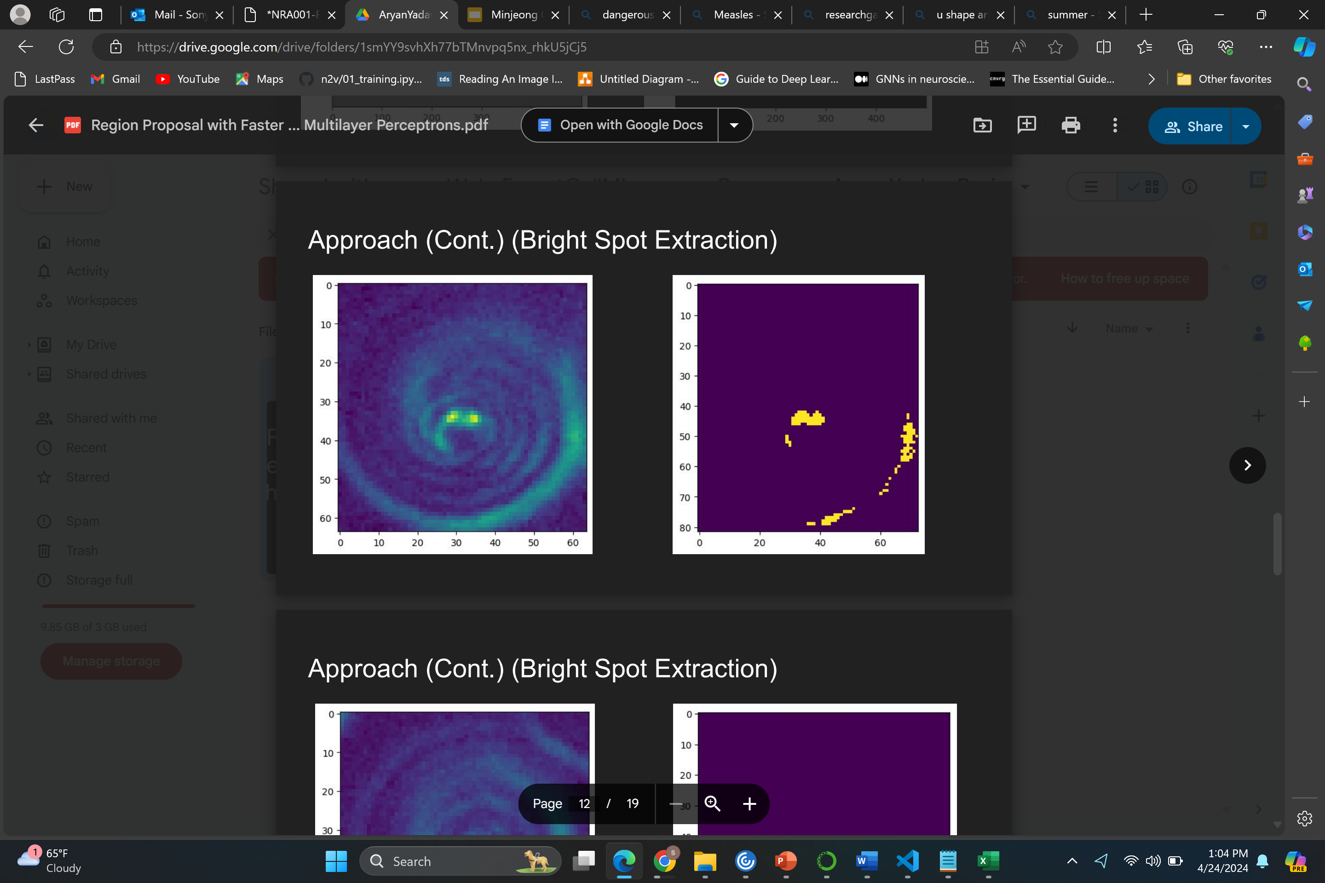
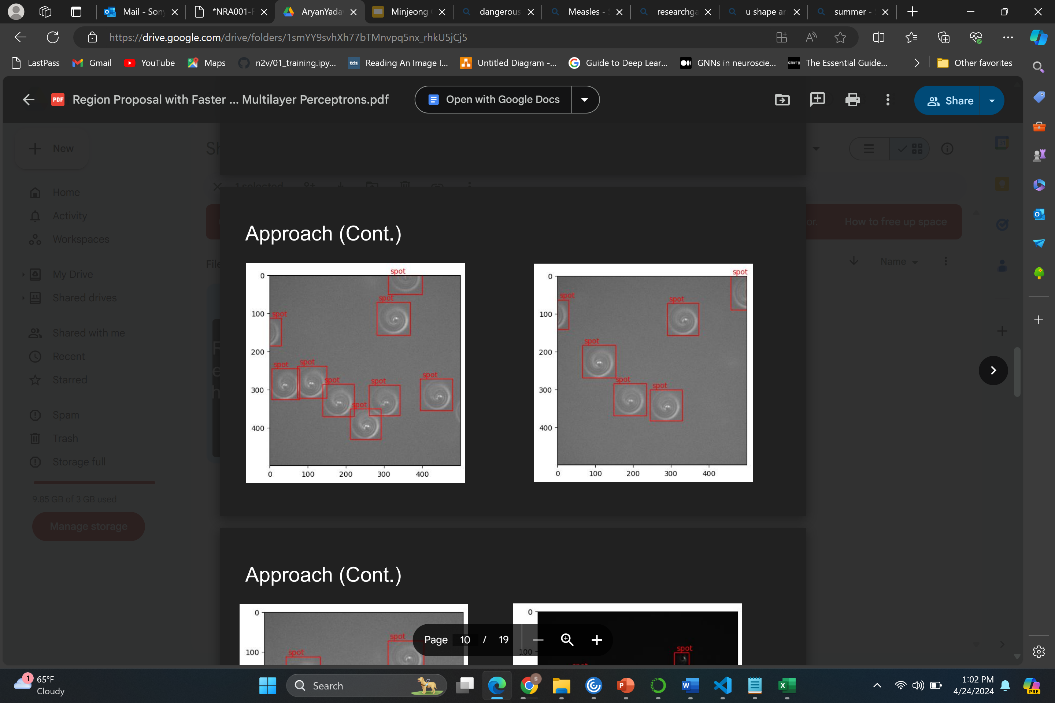
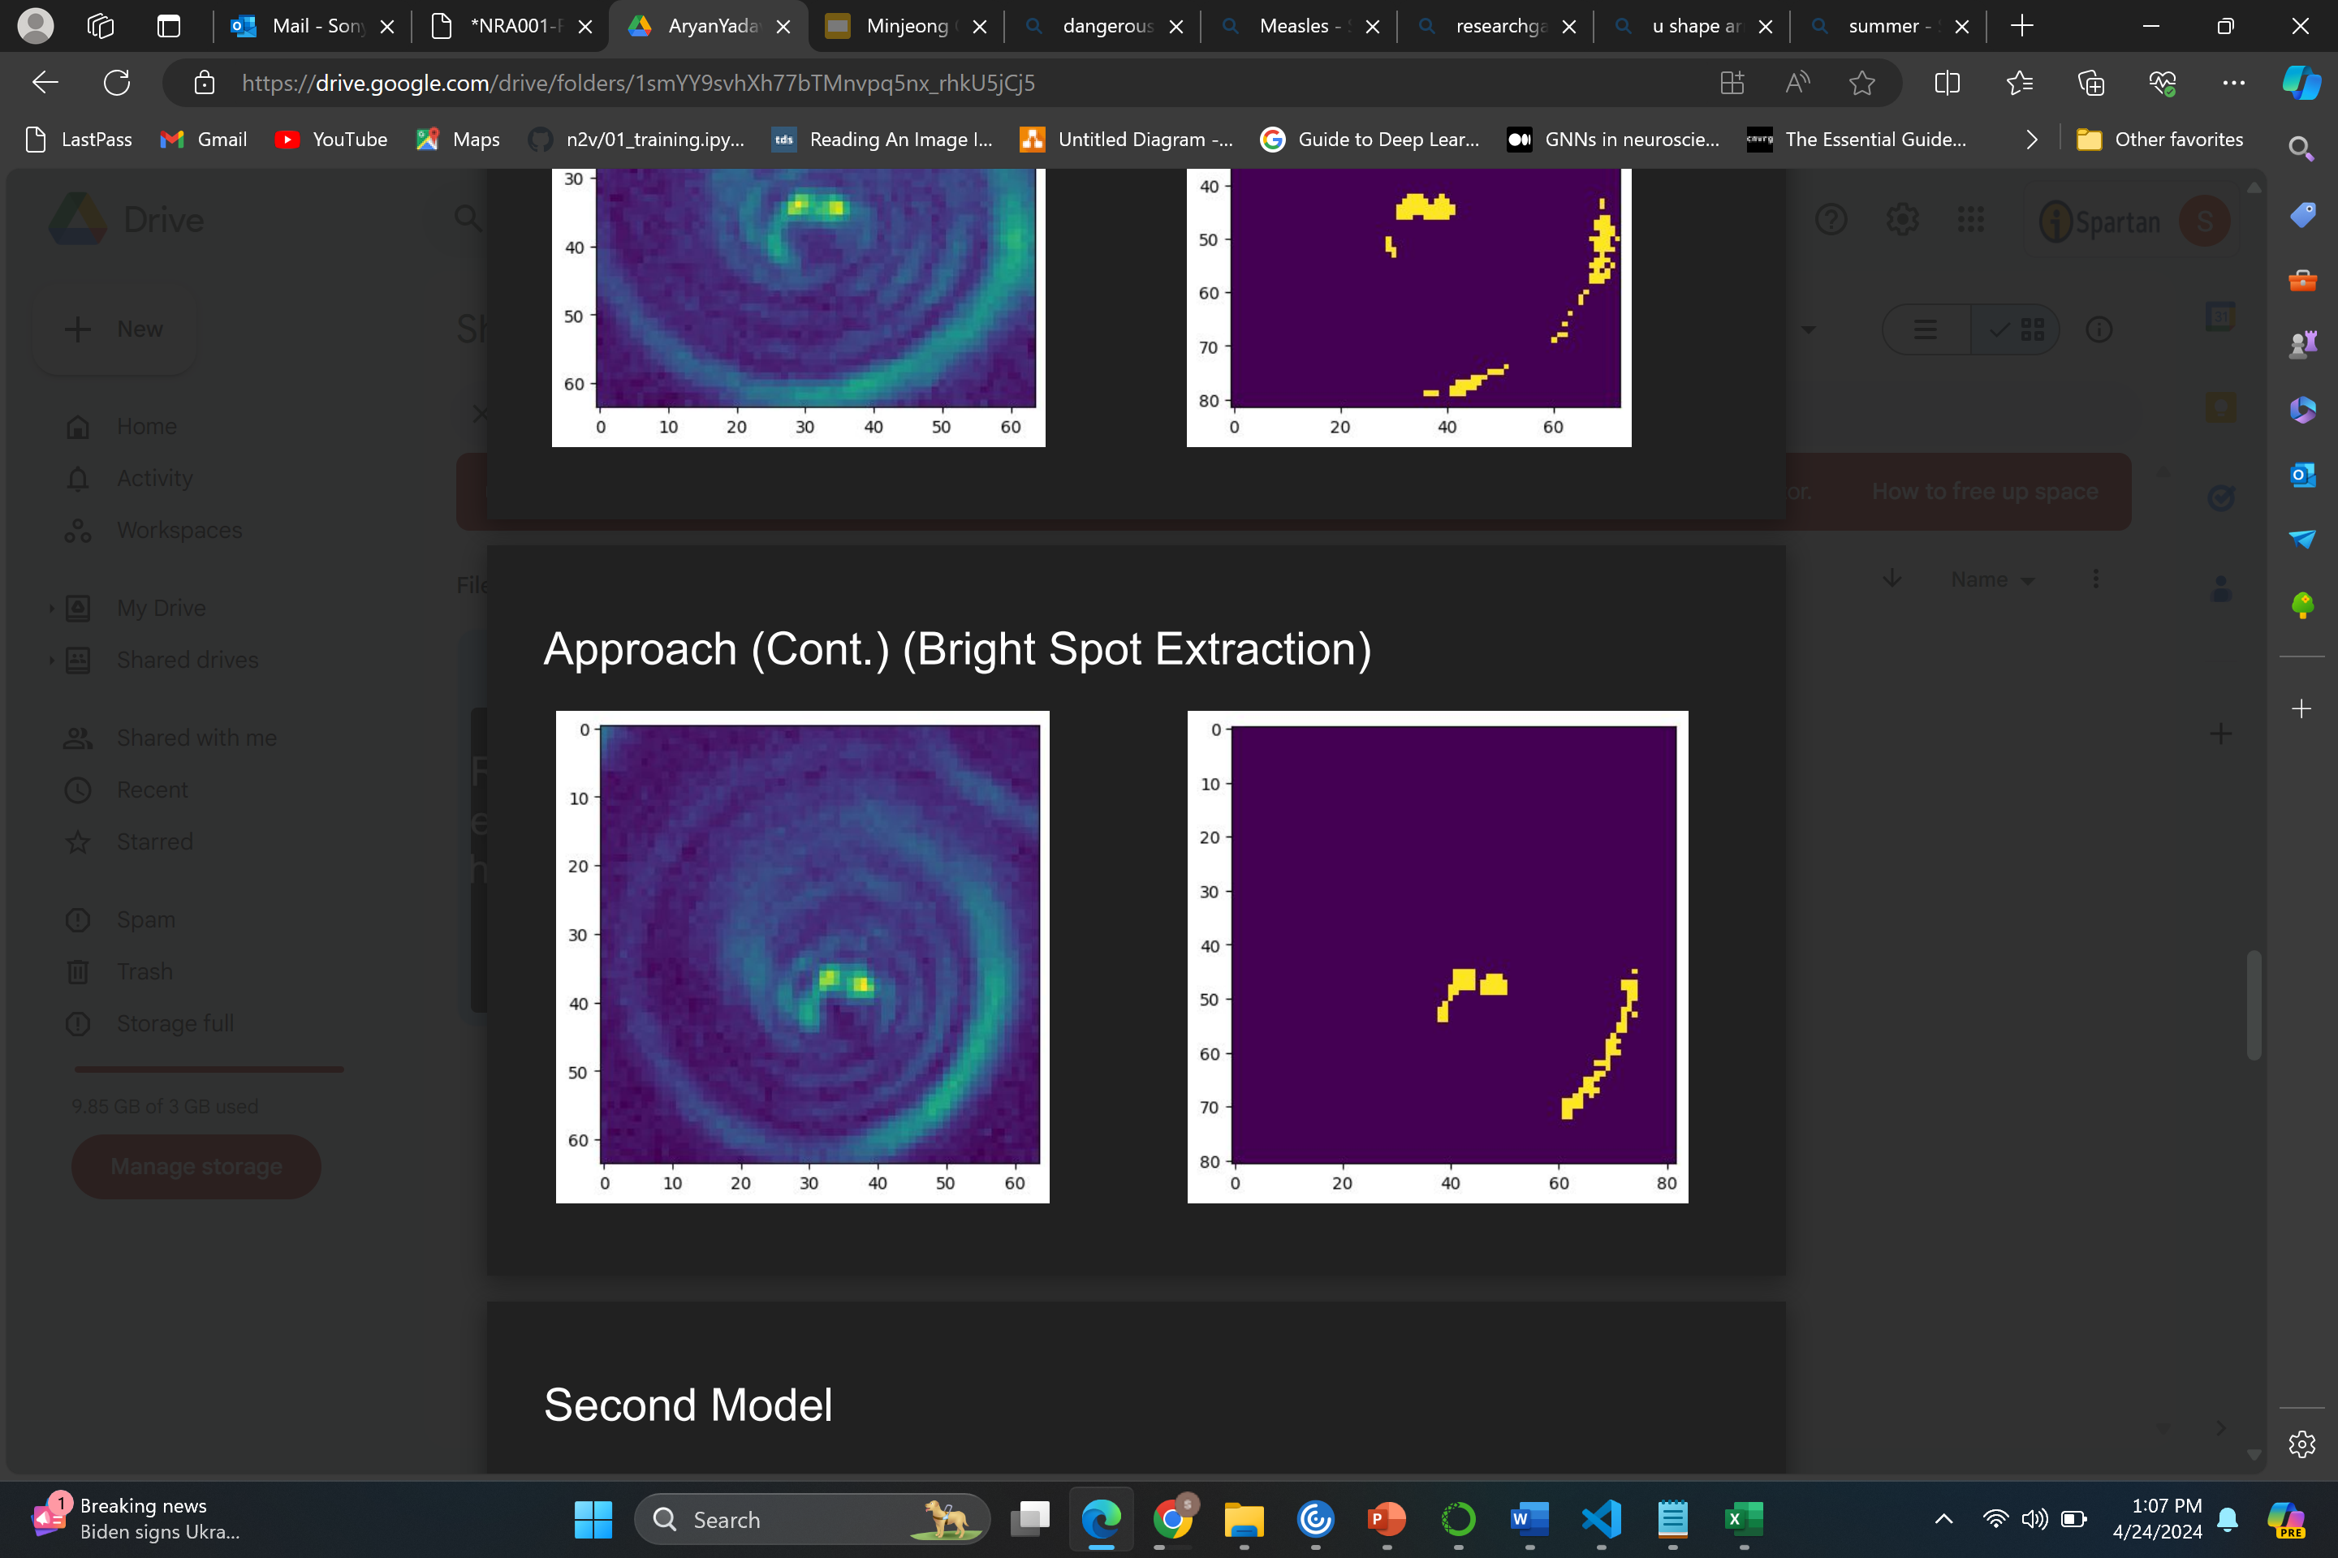
Bright Spot Extraction(work done by previous student)

Slide 22
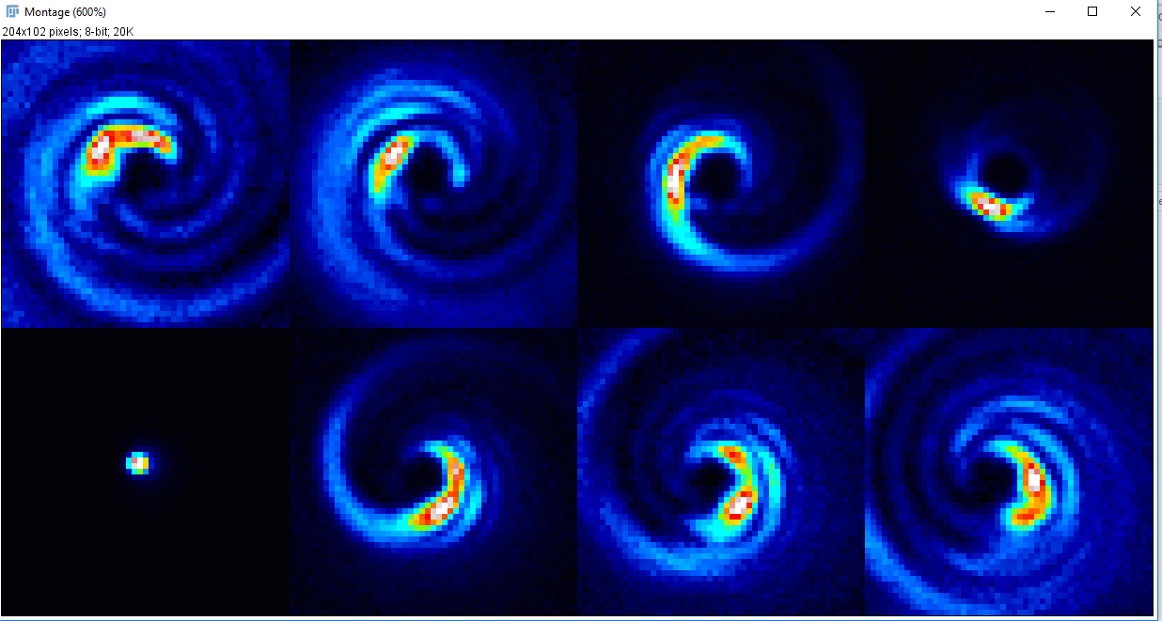

Slide 23
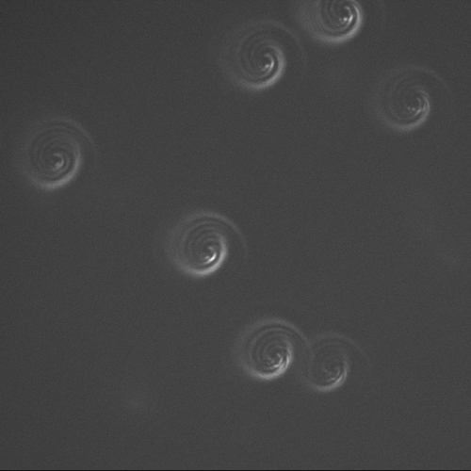



Center prediction based on bounding boxes
for box in bndboxes:
box = tuple(box)
xmin = int(box[0])
xmax = int(box[2])
ymin = int(box[1])
ymax = int(box[3])
predicted_center = (xmin + (xmax-xmin)//2, ymin + (ymax-ymin)//2)

